Slide 1

CSS-MOOC Sociological Perspectives on Modernity
Sambit Mallick
Department of Humanities and Social Sciences Indian Institute of Technology Guwahati Guwahati 781039, Assam, INDIA
Email: sambit@iitg.ac.in
January–April 2018

Slide 2
Outline
Thematic Preliminaries Sociological Modernism
Ultra-modernism: The Structuralist Interpretation Society as Human Creation: Western Marxism Synthesising Modernity and Social Theory Deconstructing Modernity
A New Totality References Acknowledgments
2

Slide 3
Thematic Preliminaries
The term ‘interrogating’ does not mean merely destruction of hitherto existing ideas.
‘Interrogating’ also refers to the dialectic of ‘engaging with’ and ‘interrogating’ hitherto existing ideas.
The ethos of ‘interrogating’ loses its significance in the absence of a critical engagement with hitherto existing ideas.
3

Slide 4
‘Engagement’ assumes greater significance in the context of not just interrogation but also interrogating the interrogator.
Both ‘engaging with’ and ‘interrogating’ are context-specific.
4

Slide 5






This course, simply put, is about “the critical modernist paradigm” in Sociology.
5

Slide 6





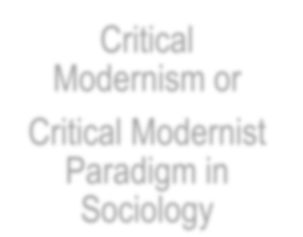








“Critical Modernism” or
“Critical Modernist Paradigm in Sociology”
Holism or Totality
Critical Modernism or
Critical Modernist Paradigm in Sociology
Social Movements
Reflexivity
Rationality
Image courtesy: amazon.co.uk 6

Slide 7
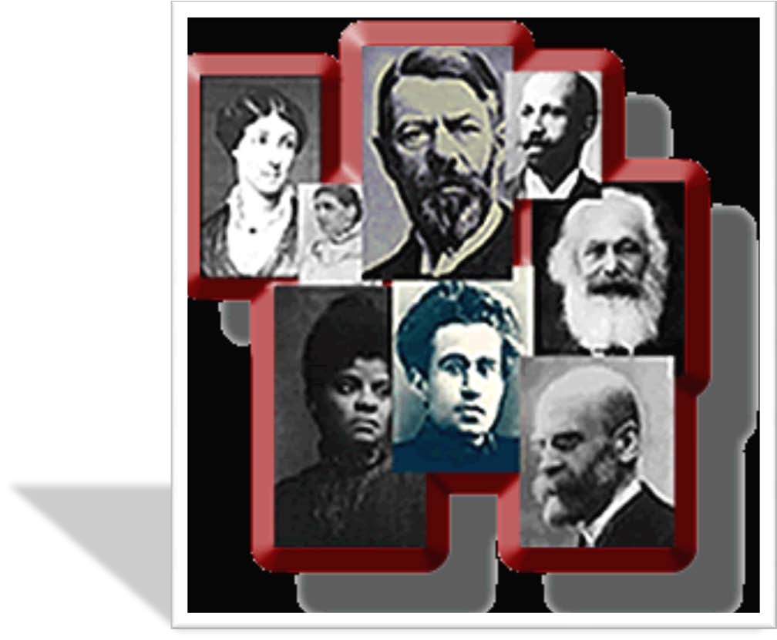
Key Thinkers in the Critical Modernist Paradigm in Sociology
7

Slide 8








the idea that “society” is a unit in some sense and that it can be studied as a single entity.
the idea that we cannot simply observe society from the outside because we are also involved in it.
the idea that we can understand society in ways which we can explain to other people.
the idea that creative human action both shapes the social whole and is shaped by it.
8

Slide 9

Why do these ideas matter and how do we get there?
C. Wright Mills’ :
to understand the larger historical scene in terms of its meaning and for the inner life and the external career of a variety of individuals
to enable us to take into account how individuals, in the welter of their daily experience, often become falsely conscious of their social positions
within that welter the framework of modern society is sought and the psychologies of a variety of wo(men) are formulated
to enable us to grasp history and biography and the relation between the two within society.
9

Slide 10

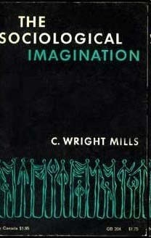

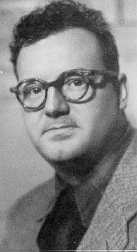
10

Slide 11





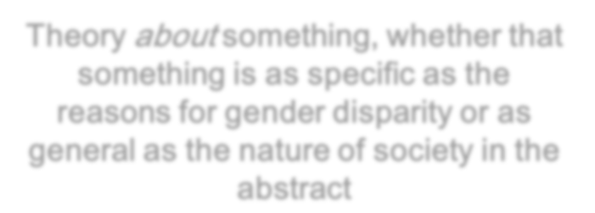
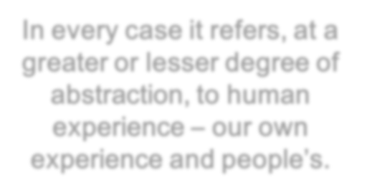


Concept Application: Working Relationship with Theory
Theory about something, whether that something is as specific as the
reasons for gender disparity or as
general as the nature of society in the abstract
In every case it refers, at a greater or lesser degree of abstraction, to human experience – our own
experience and people’s.
11
Image Courtesy: engageonline.org.uk

Slide 12





Nature of Sociological Theory
Sociological Theory consists of perspectives on the nature of the social world.
Concepts, ideas and perspectives which are transferable from one context to another making a relevant distinction between “substantive” concepts derived from the specific context and “formal” concepts which can mediate between contexts.
NOT
“laws of society”
Statements about the nature of the world; NOT “isolated categories”
The social, the interactive, the communicable

Slide 13






Ontology – the question of the nature, what is being / existing – leads on to methodology – the question of how can come to know it.
Materialist conception of history
‘It is not the consciousness of men that determines their being but on the contrary their being that determines their consciousness.’
(Karl Marx, A Preface to a Contribution to a Critique of Political Economy, 1847)

Slide 14








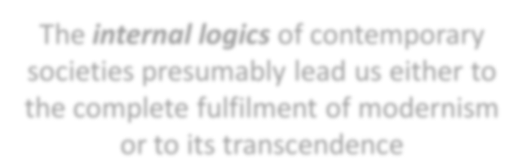
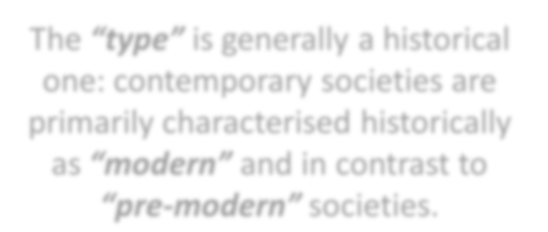










The Modernist Paradigm in Sociology: Critical themes / a set of ideas
“society” as the object of knowledge, or, more precisely, the idea of society as a unit, which can be characterised as belonging to a particular type and as determined by its own internal logics.
The internal logics of contemporary societies presumably lead us either to the complete fulfilment of modernism or to its transcendence
The “type” is generally a historical one: contemporary societies are primarily characterised historically as “modern” and in contrast to “pre-modern” societies.
A totalised version of modernity
A new social form
14

Slide 15



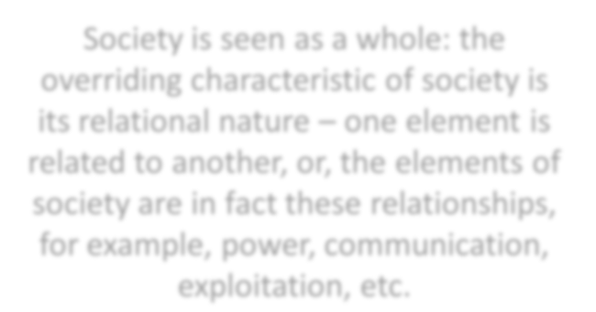












Modernity: a component part of the object of sociology – preeminently the study of modern societies, their emergence and development.
Society is seen as a whole: the overriding characteristic of society is its relational nature – one element is related to another, or, the elements of society are in fact these relationships, for example, power, communication, exploitation, etc.
Historical sociology
Implies a concept of “the social” – the economy, culture and polity – explanatory power is attached.
This concept is itself a characteristically modern one, and a characteristically sociological one.

Slide 16











“the social” includes and integrates all fields of human activity – from religion to politics, from housework to literature.
Generalisation of individual fields to explain the totality
“The social” as a residual category

Slide 17



(a) a totalising approach to the social
a methodology: a reflexive one – whatever assumptions we
make about the nature of other human beings’ experience
and knowledge needs, ceteris paribus, to be applied to ourselves
Sociologists are reflexive social actors – because we are engaged in a continuous circle of thinking about society, then thinking about our own thought as conditioned by our social being, then thinking about society once more with the social relativity of our own knowledge in mind
Reflexivity is imported into society
Montesquieu and Marx: their ideas enter into the political
and cultural self-understanding of whole societies (also C. Wright Mills commented that the “sociological imagination” was being transported into many other fields of cultural production).

Slide 18
Sociology: a social activity – significance of philosophical and sociological thinking
Social reflexivity – transition from religious or other
norms as one from their apparently natural and
certainly taken-for-granted status to a situation where
they become external roles that we play in a more or
less consciously cynical manner to one where they are
questioned in philosophical terms, where their existence is explained in terms of a theory of society, and where they are replaced by a way of living that we feel we have chosen for ourselves.
Social reflexivity needs far more ideological work to maintain on our own part than pre-modern ways of thinking.

Slide 19








Social practice: is reflexive – this reflexivity is both to be traced back to modernity and becomes a constituent element of modernity.
Social reflexivity: “social itself” comes to know itself and to create itself on the basis of this knowledge. This approach leads us in two directions.
Rationality
Social Movements
19

Slide 20



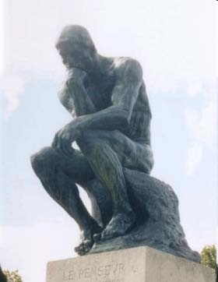
reason, self-understanding of modern society, the application of understanding
A description of the way in which we attempt to understand society – NOT simply pragmatically, NOT in terms of everyday commonsense, NOT religiously, NOT inarticulately.
Society can be understood in terms of reason.
Rationality: what it does, not it is
Image Courtesy: kamyar.wordpress.c2om0

Slide 21



self-knowing and self-creating (outside the domain of academic discourse)
Sociological imagination and everyday sociological practice: a practical attempt to understand and transform society as a whole.
Old and new social movements
Women, ecology and peace movements
Link between agency and structure – define social formations
Practical sociology

Slide 22



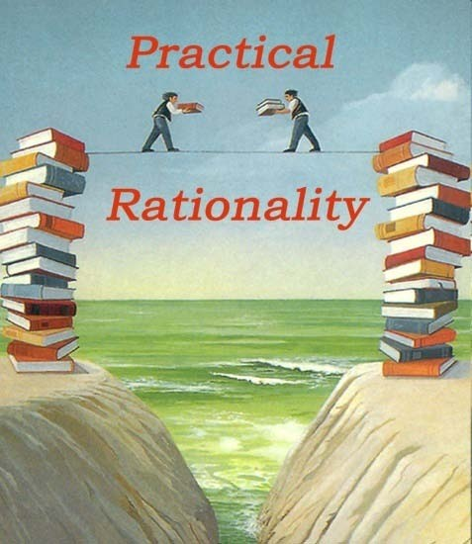
Instrumental rationality

Slide 23















Sociological Modernism
Sociology
Theoretical construct
Methodological device
An attempt to understand the dramatic transformations that Western Europe experienced between the mid-C18th and the mid-C20th
Image Courtesy: healeylibrary.wikispaces.co2m3

Slide 24












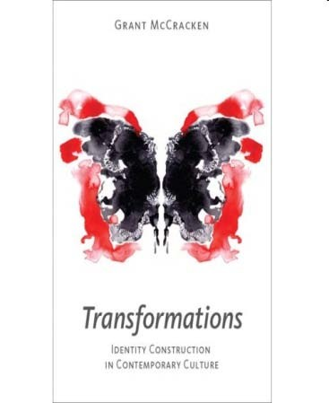
Dramatic transformations
Economy
Polity
Culture
24
Image Courtesy: cultureby.com

Slide 25




(i) Transformation of agriculture into a profit-oriented and
increasingly technological activity, with the marginalisation
of farm labourers and tenant farmers and their flight to the growing urban centres of population
Development of large-scale industrial manufacturing
processes, the corresponding decline of artisanal and home production and the rise of trade unions
(ii)
(iii) Increasingly global dimensions of trade, as more and more
of the world is drawn into the global economy and the non-
European world is increasingly turned into colonial
possessions designed to supply cheap or free labour, basic commodities and protected markets for the imperial centre

Slide 26


Spread of literacy via the developing mass education systems and the increasing significance of print media, participation of individuals in national cultural formation
Dominant languages increasingly marginalise other languages and dialects
The system of social control represented by the official churches breaks down, particularly in urban areas

Slide 27




(i) Democratic movements make monarchic and aristocratic power increasingly untenable, and even authoritarian government increasingly requires the active participation of its citizens to sustain itself
The capacity of the State to intervene is transformed by its growing power of administration and surveillance, the development of large-scale standing armies based on mass conscription, and its increasing significance as an economic actor
(ii)
(iii) Democratic and socialist movements and revolutions become a central part of European political development, but meet increasing opposition from a modernising and authoritarian right.

Slide 28





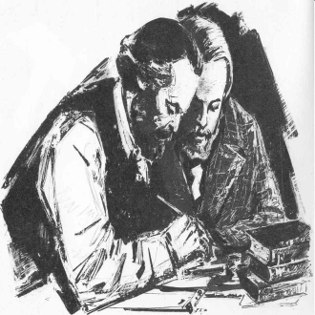
Karl Marx and Modernity
Marx and Engels are among the earliest and most perceptive of those observers who did not adopt either an affirmative modernist or a straightforwardly reactionary position.
Modernity as inevitable, yet in many senses deeply undesirable – and who therefore sought to identify how modernity could itself be transformed into an ideal future, rather than simply returning to an idealised past.
Rejection of an idealised past: modernity is seen as itself a product of the past – a past society which is therefore not stable, but inherently likely to generate modern formations.

Slide 29



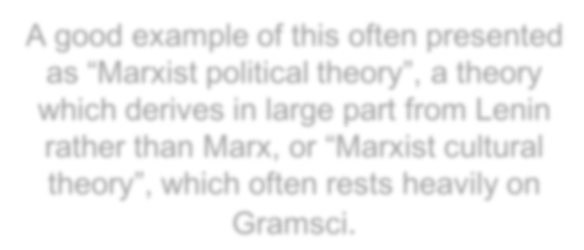
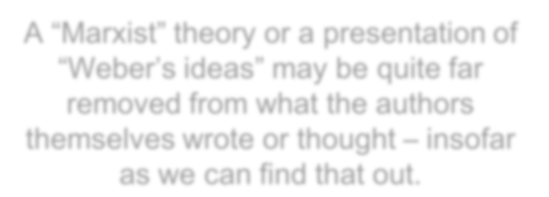






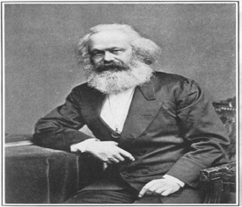
Methodological Warnings:
Some of Marx’s most important writings remained unpublished for decades after his death, and his immense intellectual and political status meant that many of his followers legitimated their own ideas by presenting them as supported by his authority.
A “Marxist” theory or a presentation of “Weber’s ideas” may be quite far removed from what the authors themselves wrote or thought – insofar as we can find that out.
A good example of this often presented as “Marxist political theory”, a theory which derives in large part from Lenin rather than Marx, or “Marxist cultural theory”, which often rests heavily on Gramsci.
Image Courtesy: commons.wikimedia.o2r9g

Slide 30

“Orthodox Marxism”, in the sense of the theories approved by the parties of the 5th International, is something different again.
30

Slide 31







Marx’s view on modernity is deeply shaped by own involvement in the Europe of his day.
A political activist – involved with radical and
socialist organisations in Britain and France as well as in the first socialist International.
Most importantly, though, was his intense intellectual involvement with his own society.
The collected works of Marx and Engels run
to over 40 volumes on social philosophy,
economic analysis and political comment,
which taken together represent a phenomenal amount of empirical research.
31
Image Courtesy: eserver.org

Slide 32
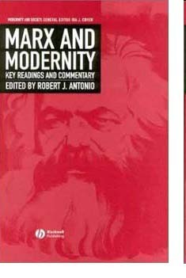

Slide 33


























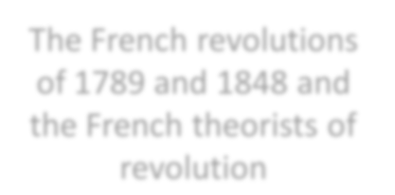
Marx’s idea of modernity was shaped by three developments:
German philosophy
British economy
French politics
Collapse of the official Church’s intellectual credibility
Industrial and agricultural revolutions in Britain
The French revolutions of 1789 and 1848 and the French theorists of revolution

Slide 34
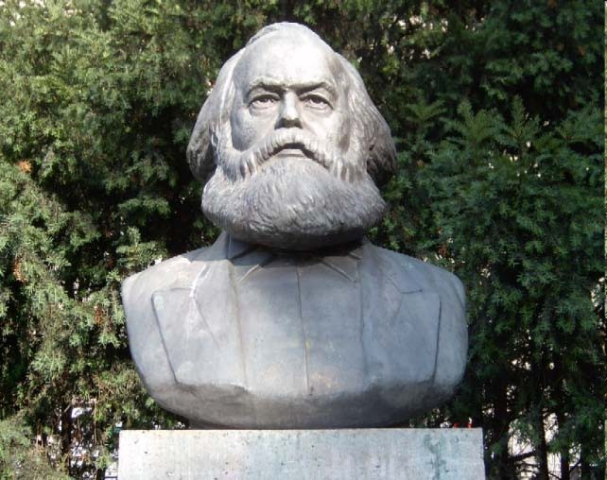
Marx’s empirical starting-point for thinking about the new society is
largely a projection of each of these developments into the future.
34
Image Courtesy: wanderingscholar.org

Slide 35

Holism / Totality
For Marx, modern society is above all capitalist society.
Modernity, or “the capitalist mode of production” is contrasted with an earlier society which is described as “feudal”, as well as even earlier stages which we need not get into.
Modern society as capitalist?

Slide 36



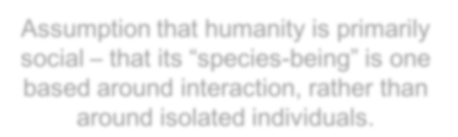






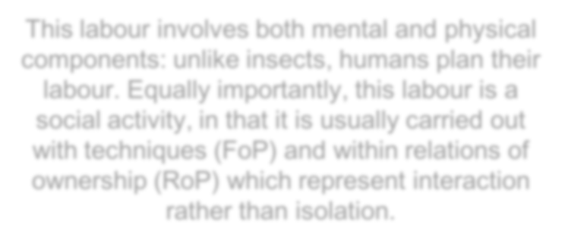

Marx: described his social theory as “the materialist conception of history”.
This “materialist conception of history” has two primary starting-points.
Assumption that humanity is primarily social – that its “species-being” is one based around interaction, rather than around isolated individuals.
The defining characteristic of humanity is productive labour – the transformation of nature into material to meet human needs.
Human beings are always found in social contexts; their characteristic activities, what sets them apart from other species, are all social ones.
This labour involves both mental and physical components: unlike insects, humans plan their labour. Equally importantly, this labour is a social activity, in that it is usually carried out with techniques (FoP) and within relations of ownership (RoP) which represent interaction rather than isolation.

Slide 37

Labour is, in the first place, a process in which both man and Nature
participate, and in which man of his own accord starts, regulates, and
controls the material re-actions between himself and Nature. He
opposes himself to Nature as one of her own forces, setting in motion
arms and legs, head and hands, the natural forces of his body, in order to appropriate Nature’s productions in a form adapted to his own wants.
By thus acting on the external world and changing it, he at the same
time changes his own nature. He develops his slumbering powers and
compels them to act in obedience to his sway. We are not now dealing
with those primitive instinctive forms of labour that remind us of the mere animal.
An immeasurable interval of time separates the state of things in
which a man brings his labour-power to market for sale as a
commodity, from that state in which human labour was still in its first
instinctive stage. We pre-suppose labour in a form that stamps it as exclusively human.

Slide 38

… A spider conducts operations that resemble those of a weaver, and a bee puts to shame many an architect in the construction of her cells. But what distinguishes the worst architect from the best of bees is this, that the architect raises his structure in imagination before he erects it in reality.
At the end of every labour-process, we get a result that already existed in the imagination of the labourer at its commencement. He not only effects a change of form in the material on which he works, but he also realises a purpose of his own that gives the law to his modus operandi, and to which he must subordinate his will. And this subordination is no mere momentary act. Besides the exertion of the bodily organs, the process demands that, during the whole operation, the workman’s will be steadily in consonance with his purpose.
This means close attention. The less he is attracted by the nature of the work, and the mode in which it is carried on, and the less, therefore, he enjoys it as something which gives play to his bodily and mental powers, the more close his attention is forced to be [Karl Marx, Capital (Volume I), 1867].
Image Courtesy: freepages.genealogy.rootsweb.ancestry.com

Slide 39



Social Movements
Marx identifies the opposition between those who depend on selling their labour-power (the working class) and those who own the means of production (capitalist class).
For Marx, because the history of the human species is the history of its social labour, the development of new MoPs is itself a human history – more than that, it is the history of a class.
(Marx, The Manifesto of the Communist Party, 1848).
The development of the capitalist MoP not only generates a new class capitalists; it is at the same time a result of their creative activity.

Slide 40



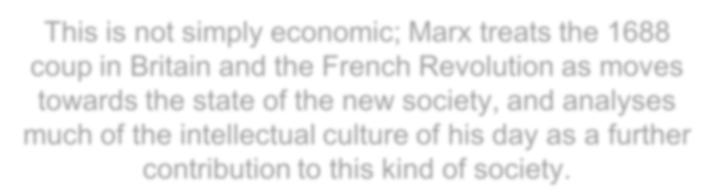


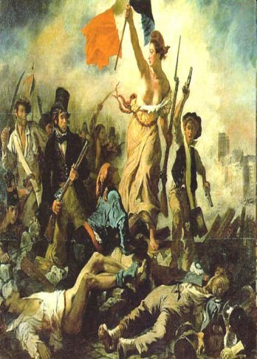
This class shapes society in its own image, at the same time as it is itself shaped by the MoP it is developing.
This is not simply economic; Marx treats the 1688 coup in Britain and the French Revolution as moves towards the state of the new society, and analyses much of the intellectual culture of his day as a further contribution to this kind of society.

Slide 41




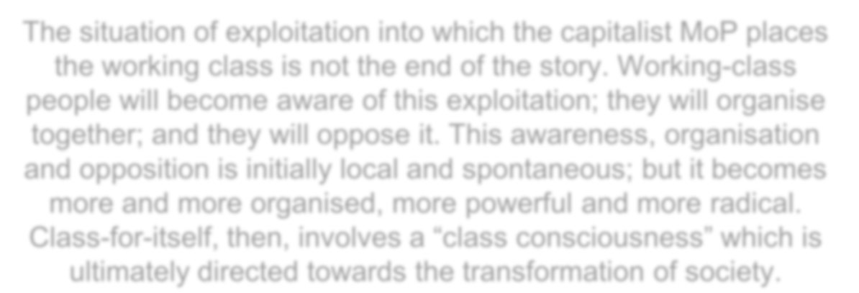
Stages of different modes of production
Transition from class-in-itself to class-for-itself
The situation of exploitation into which the capitalist MoP places the working class is not the end of the story. Working-class people will become aware of this exploitation; they will organise together; and they will oppose it. This awareness, organisation and opposition is initially local and spontaneous; but it becomes more and more organised, more powerful and more radical.
Class-for-itself, then, involves a “class consciousness” which is ultimately directed towards the transformation of society.

Slide 42
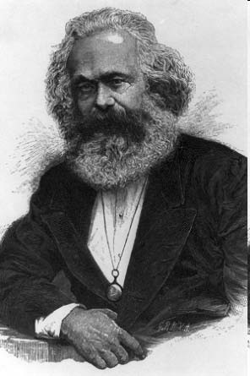
Social movements, then, in the form of class movements, are instrumental both in forming the major events within particular social forms and in transforming one social form into another.
Marx’s holism is based on the argument that the history of humanity is a history of social labour: this in effect turns humanity into a self-creating subject.

Slide 43

Reflexivity and Rationality
Humanity: not simply a self-creating subject; it is also, to a greater or lesser extent, a self-knowing subject
Our thinking and communication with one another is closely linked to our practical interaction with each other.
The theories that intellectuals articulate about the nature of society are shaped by this everyday experience, whether it is their own or – as it often is – someone else’s.

Slide 44

Ideology: the ideology of the dominant class is the dominant ideology
Ideologies rule the world
Reflexivity, for Marx, is primarily a matter of awareness that theory is ideological and of searching for a position from these partial perspectives on society can coincide with the universal.

Slide 45
“The rational is the real”: a rational understanding is an understanding of reality which is valid because it starts from valid premises.
In this sense, Marx treats his replacement of accounts of human history in terms of the development of philosophy, art, religion, and so on by accounts in terms of the development of social production as a move towards rational understanding; and there is a suggestion that by choosing to theorise from the position of the “universal” working class, he is guaranteeing a correspondence between the ideological and the rational, between socially- determined thinking and a valid understanding of reality.

Slide 46
Capitalist rationality: a particular mode of
production involves the imposition of a particular
logic - for example, a logic of the exchange of
commodities - on all social interaction:
everything becomes a commodity, to be bought and sold on the market.
Another feature of this “capitalist rationality” is
the accumulation of capital - in other words, of economic power - in ever-fewer hands.
Image Courtesy: paradigm-shift-21st-century.n4l6

Slide 47

47

Slide 48
Lastly, there is a suggestion that history has a rational
potential, in other words that the actual interaction of
human beings in social production can be understood, brought to serve their own needs, and transformed into a situation of mutual communication and interactive self- realisation.
This involves suggesting both a movement towards a form of
production which does not involve domination and exploitation of one human being by another and a movement to a form of ideological thinking which is universal and therefore represents a valid understanding of reality.

Slide 49
This idea of rationality, in other words, is a complex one which can refer either to modes of understanding or to an assumption that the way the world works or can work is related to the way we think or can think.
This last assumption can be defended in terms of the statement that the social world is a human creation: the link between the way we act and the way we think means that the real is ultimately the rational.
49

Slide 50



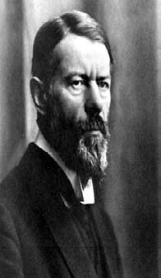
Max Weber’s Methodology
Weber contributed heavily to the development of substantive sociological theory and to the debate on methodology.
Weber’s methodological writings are usually characterised as effecting a reconciliation between
Positivism
Neo-Kantianism
Image Courtesy: britannica.co5m0

Slide 51








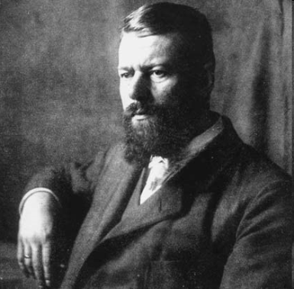
Though Weber’s positions were not, of course, entirely consistent throughout his life, it is possible to say that, in general, Weber rejected the view attributable to some neo-Kantians (though not Rickert) that the cultural sciences are exclusively concerned with the uniqueness of their objects of study, and that the category of causality is inapplicable in them.
Weber was committed to neo-Kantian insistence on the methodological peculiarities of the cultural sciences.
For Weber, these peculiarities centered around the two related concepts:
Value-relevance
Interpretative understanding
51
Image Courtesy: picses.eu

Slide 52

For Weber, the cultural sciences differ from the natural sciences in the distinctive role of valuations in the formation of concepts, and in the distinctive type of knowledge involved in them.
A third area of methodological differences was thought by Weber to be the use of ‘idealisations’ in the cultural sciences.
Image courtesy: unc.edu
52

Slide 53


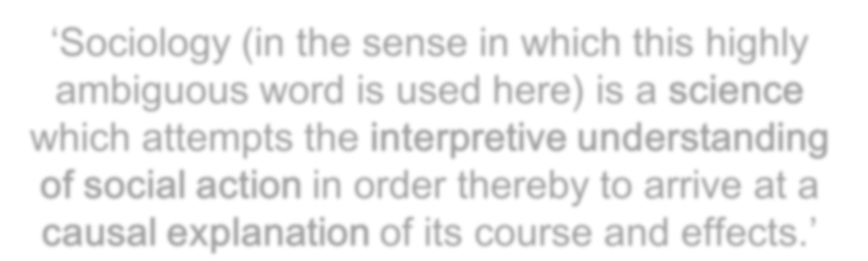


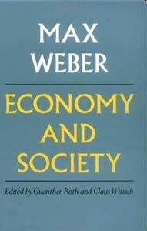
Interpretative Sociology
‘Sociology (in the sense in which this highly ambiguous word is used here) is a science which attempts the interpretive understanding of social action in order thereby to arrive at a causal explanation of its course and effects.’
53

Slide 54
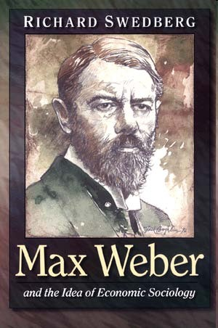
An exposition of Weber’s methodological position can usefully proceed with an analysis of each of the concepts and contrasts involved in the definition.
Image courtesy: press.princeton.edu
54

Slide 55


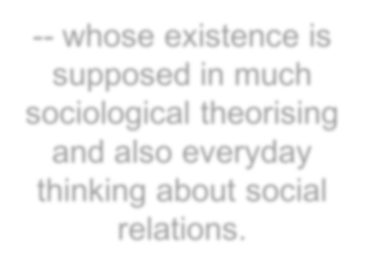
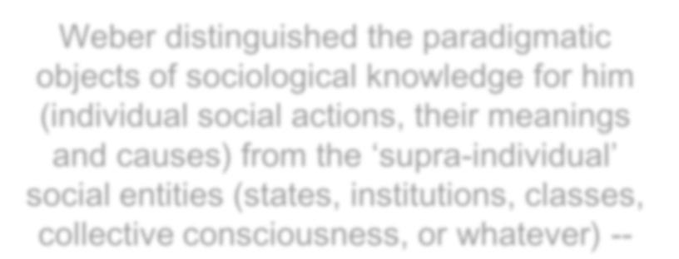





Concept of Social Action: the characterization of Sociology in terms of the understanding and
explanation of social action involves two important contrasts.
Weber distinguished the paradigmatic objects of sociological knowledge for him (individual social actions, their meanings and causes) from the ‘supra-individual’ social entities (states, institutions, classes, collective consciousness, or whatever) --
-- whose existence is supposed in much sociological theorising and also everyday thinking about social relations.

Slide 56

Weber does not actually deny the existence of such ‘entities’, but argues that for interpretative sociology they must be ‘treated as solely the resultants and modes of organisation of the particular acts of individual persons…’
Weber’s position here would now be regarded as
, involving the claim that insofar as collectivities may be said to have characteristics independent of the individuals which make them up, those characteristics are to be explained in terms of individual actors and their actions.

Slide 57

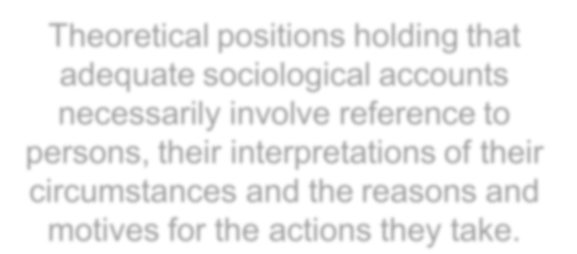




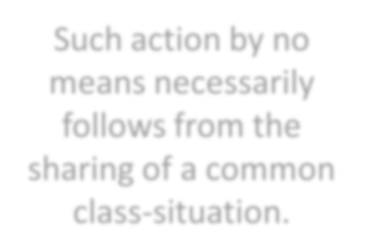


Methodological Individualism:
Theoretical positions holding that adequate sociological accounts necessarily involve reference to persons, their interpretations of their circumstances and the reasons and motives for the actions they take.
Such action by no means necessarily follows from the sharing of a common class-situation.

Slide 58
Interpretative Understanding
Interpretive Sociology: a variety of forms of sociology united by an emphasis on the necessity for sociologists to grasp or ‘understand’ or interpret actors’ meanings.
It can legitimately interpret course of action in terms of concepts such as the State, classes, etc. without commitment to any of the entities.
Interpretative understanding: a method that stresses the importance of understanding of intentional human action.

Slide 59







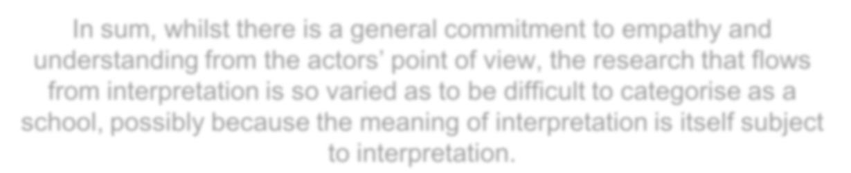
Understanding or ‘Verstehen’ (Weber):
A method of elucidating the motivations for action which did not prelude the sociologist making generalisations from the data.
In sum, whilst there is a general commitment to empathy and understanding from the actors’ point of view, the research that flows from interpretation is so varied as to be difficult to categorise as a school, possibly because the meaning of interpretation is itself subject to interpretation.

Slide 60



Slide 61
Verstehen is not a method at all but an ‘objective’, an ‘achievement’ – it is a distinctive type of knowledge which may be achieved by a variety of methods, or no ‘method’ at all.
For Weber, the concept of ‘Verstehen’ refers primarily to the spontaneous and immediate ‘recognition’ of acts and their meanings in everyday life.
61
Image Courtesy: psychology.wikia.com

Slide 62

62

Slide 63










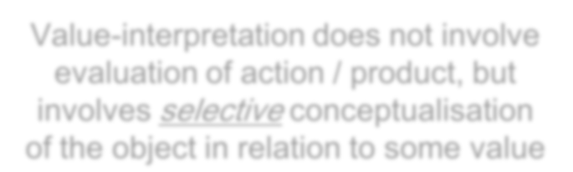













Interpretative Understanding has two parts:
Cultural relevance + Meanings = Value-interpretation (Values)
Interpretation of the textual and linguistic meaning of a cultural product
Value-interpretation does not involve evaluation of action / product, but involves selective conceptualisation of the object in relation to some value
Social value
Cognitive value
Aesthetic value
63
Image Courtesy: dmacc.edu

Slide 64











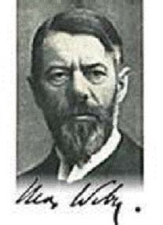
Selection is based on cultural relevance.
Value, for a sociologist, is always an object of study.
Interpretative Understanding
Direct (Observational) Understanding
Indirect (explanatory) Understanding
64
Image courtesy: nortonbooks.typepad.com

Slide 65
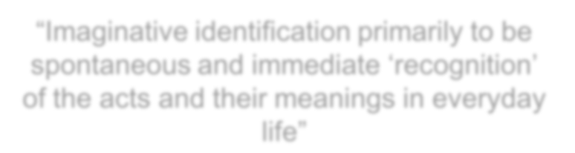










It is based on the interpretative understanding of action.
It involves a method or a strategy:
“Imaginative identification primarily to be spontaneous and immediate ‘recognition’ of the acts and their meanings in everyday life”
This imaginative identification is processed through rule- governed strategy within a shared culture.
It is possible only when both observer and observed share culture.

Slide 66
















Rule-governed Shared Culture
Relevance
Acceptability
Elegance

Slide 67

If observer and observed do not share culture, then:
Observer may give a different meaning, or
Observed should get socialised into the culture that the observer wants to study.

Slide 68
Culture (Weber):
The totality of real objects to which we attach generally acknowledged values or complexes of meaning constituted by values.
Culture consists of all those items produced by human beings for the sake of value-ends.

Slide 69

Verstehen comprises two things:
Imaginative identification is useful but it is not an essential condition for a meaningful action.
Recognition of the rational connection between means and ends.

Slide 70





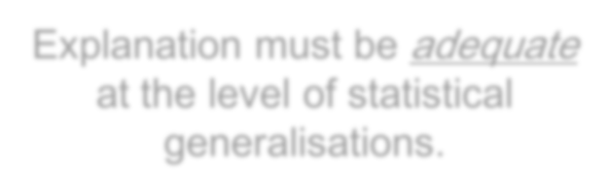







Indirect (Explanatory) Understanding
Explanation must be adequate at the level of meaning.
Explanation must be adequate at the level of statistical generalisations.
Adequacy is based on generalisations and generalisations are based on experience.

Slide 71
There is a probability that a particular action often occurs in the same way.
If motives are the antecedent, then social action will be the consequent.
Motive (Weber): a complex, subjective meaning
which seems to the actor herself or himself or to
the observer as an adequate ground for the conduct in question.
Multiple motives can lead to a similar / same kind of social action.

Slide 72



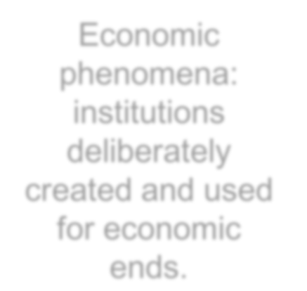




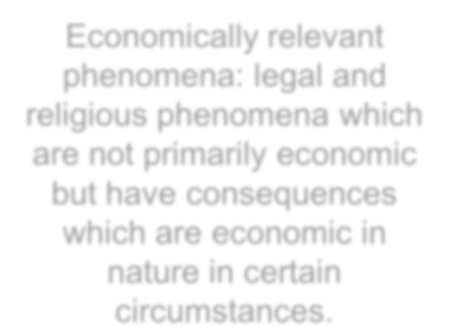


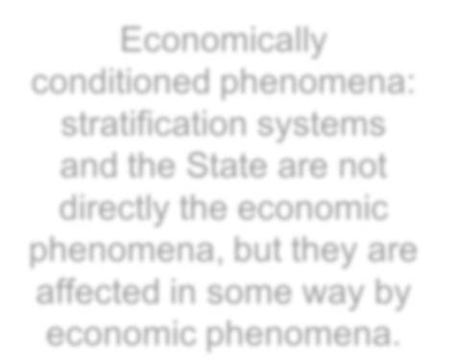
The central dimensions of Weber’s analysis are that economic, religious and power relations are crucial sociological explanations.
Weber made three types of economic phenomena:
Economic phenomena: institutions deliberately created and used for economic ends.
Economically relevant phenomena: legal and religious phenomena which are not primarily economic but have consequences which are economic in nature in certain circumstances.
Economically conditioned phenomena: stratification systems and the State are not directly the economic phenomena, but they are affected in some way by economic phenomena.

Slide 73





Slide 74


Weber’s Interpretation of Modernity
Marx is not a Sociologist in the disciplinary sense for the simple reason that he is not an academic.
Weber is, or rather became, a Sociologist, because he is living and working as an academic at the point where sociology is developing as a separate discipline.
Indeed, Weber moves from the study of law, political economy and history to an identity as a Sociologist.

Slide 75

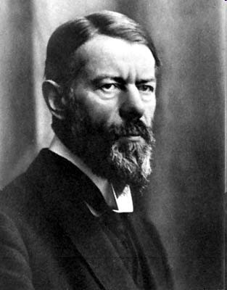
This shift has important consequences:
Whereas Marx, the activist thinker, is working towards a global theory which renders the older disciplinary division of labour obsolete by showing the interrelation between the different spheres of life, Weber sets out to define Sociology as different from other humanities and social sciences, and restricts its scope – in theory, at least – more perhaps than any comparable sociological theorist, to the point where, if we are to hold ourselves to his explicit statements, it would be impossible to describe him as a holist.

Slide 76

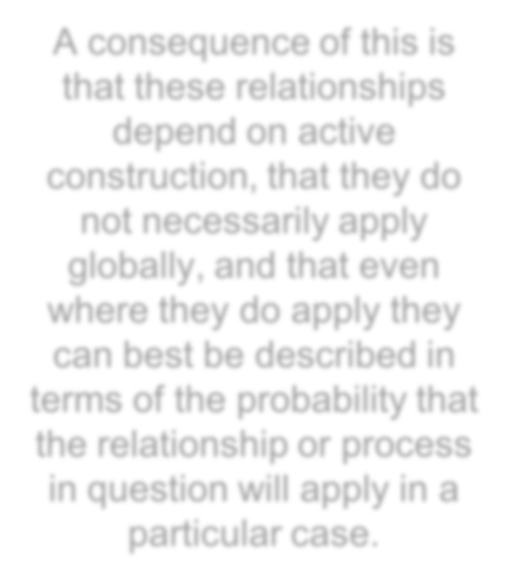






There are a number of steps in this narrowing of the jurisdiction of sociology.
First, Weber takes what is known as a “methodologically individualist” position: in other words, Weber assumes that all statements about the human world can in principle be reduced to statements about individuals and aggregates of individuals.
A consequence of this is
that these relationships depend on active construction, that they do not necessarily apply globally, and that even where they do apply they can best be described in terms of the probability that the relationship or process in question will apply in a particular case.
Treating individuals, rather than relationships between individuals, as primary.

Slide 77





Secondly, Weber restricts the scope of sociology as a discipline to the study of meaningful social action: in other words, to the action of these individuals insofar as their action is oriented towards each other and insofar as they attach meaning to it.

Slide 78




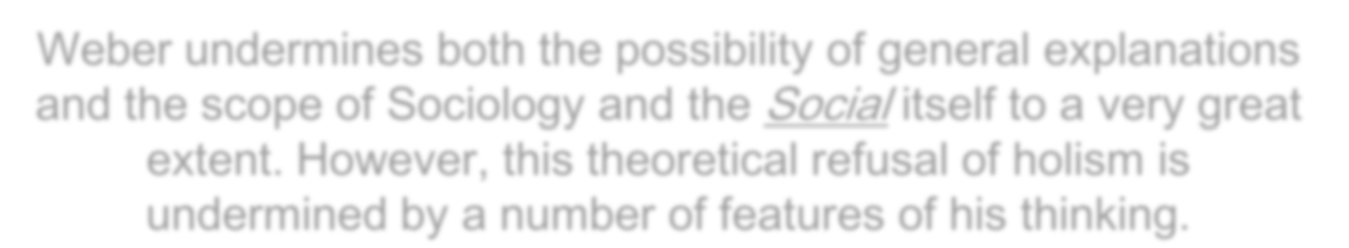
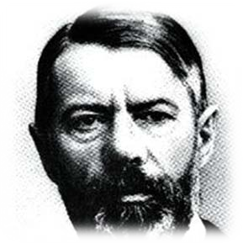
So Weber is not a straightforward holist:
Weber undermines both the possibility of general explanations and the scope of Sociology and the Social itself to a very great extent. However, this theoretical refusal of holism is undermined by a number of features of his thinking.
Image courtesy: apsu.edu

Slide 79

There is a tension between the statement that we start from individuals rather than relationships and the statement that what we are interested in is the way those individuals orient their action to each other, in other words, their interaction.
The effect of this becomes clear when we consider the second element of Weber’s definition of sociology: that it is not just about social action, but about meaningful social action.

Slide 80
Weber proceeds to develop a categorisation of the types of meaning which can be attached to social action: a categorisation which appears in some senses as a general statement of the kinds of ways in which people can relate to one another, or in other words precisely the kind of general statement about social relationships that methodological individualism finds suspect.
These types of social action reappear in a number of forms, for example as the different ways in which a given power structure can find legitimation.

Slide 81





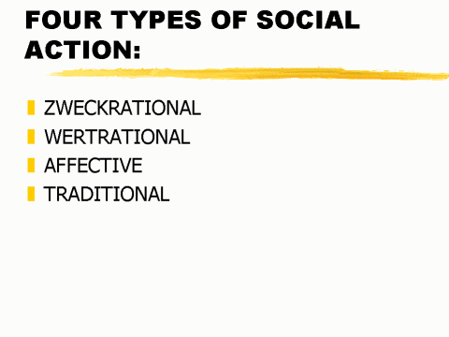
Typology of Social Action
Traditional : meanings of action are related simply to habit and custom, and are described by Weber as coming close to having no meaning, because unreflective.
Affective action relates to the emotions, and is equally seen as often meaningless in these terms.
The major distinction of clearly meaningful action, then is between the last two categories: the value- rational and the goal-rational.

Slide 82
Value-rational action treats action as having a value in itself, which is independent from its effect, and derives, for example, from moral, aesthetic or religious criteria.
Goal-rational, or instrumental, action, is oriented purely towards desired results (this last category is particularly associated with Weber’s account of modernity, which he sees as a progressive extension of this principle of instrumental rationality, which sees action as deriving its sole meaning and interest from its results, to dominate all contemporary society.

Slide 83
For Weber, the history of modernity is the history of the progressive orientation of all social action, in all contexts, to instrumental rationality.
This rationalisation of social life involves an ever-greater development of technical means and a progressive orientation of the ends towards which these means are supposed to lead.

Slide 84
In The Protestant Ethic and the Spirit of Capitalism,
Weber argues that Calvinist and Dissenting religion represented a rationalisation of human behaviour, which focused people’s constant attention on the relationship between their everyday activity and their hope of salvation.
All behaviour was scrutinised to see whether or not it represented a waste of time, and thus possibly an indication that one was not destined for salvation.
This obsession with making the most of each minute, with the rationalisation of everyday life, particularly economic life, gradually came to take complete precedence over the intended goal, of demonstrating to oneself that one was likely to be destined for salvation.

Slide 85



Slide 86
Weber’s analysis of the development of bureaucracy is similar.
Bureaucracy, for Weber, is simply the most technically efficient means of organising the action of a State.
Thus, bureaucratic means of organisation come to predominate in modern societies irrespective of the actual goals which they are supposed to serve.
Increasingly bureaucracy takes on a life and a logic of its own that renders its ultimate goal irrelevant.
In Weber’s terminology, formal rationality, the (instrumental) rationality of a particular form, leads to substantive irrationality, a content which is in fact derived from the form and not from the goal that the formal rationality is supposed to serve.

Slide 87
Capitalism itself is a very important instance of this general rationalisation of behaviour that characterises modern society: Weber defines it in terms of the rationalisation of the pursuit of profit, a rationalisation which ultimately implies that the individuals to whom this profit is accruing are not in a position to enjoy its possession, but must rationalise their own lives, replacing an aristocratic lifestyle based effectively on the service of profit rather than its enjoyment.
Once again the means becomes the end.
Weber’s account of modernity as the progressive extension of rationalisation, and his scepticism about the possibility of reversing this trend, makes his view of modernity, at least, effectively a holistic one.

Slide 88


Weber’s view on social movements, however, is less holistic; and here he serves as a prototype for that approach which sees structures – of rationality, for example – as ultimately more deeply founded than collective action; even though both are of course his own terminology simply forms of meaningful social action. This can be illustrated in relation to his approach to social class.

Slide 89
It is traditional to represent Weber’s views on class as representing a rejection of Marx’s; there is some truth in this, but it is only partial.
For example, Weber agrees with Marx that the workers’ movement is an extremely significant and powerful movement, and even sees a successful illustration of a socialist regime as a possibility. However, Weber argues that it will be forced to adopt bureaucratic means in order to reach this goal – and hence that the socialist regime would represent an intensification of instrumental rationalisation at the expense of any possibility of achieving the substantive rationalities that were aimed at.
Equally, Weber accepts that not only that economic class is a fundamental basis for social action but even that status differences are increasingly eroded by economic class in modern society.

Slide 90
Two primary differences between Weber and Marx on class:
The first is in their conception of the economic class structure that underlies class movements. For Marx, we have seen, this can ultimately be reduced to a primary opposition between the exploited and the exploiters, those who labour and those who live off their labour. For Weber, however, economic situation is not so much a relationship as a given, which individuals bring to a market. Schematically, we can say that individuals bring their labour-power, or their skills, or their ownership of the means of production to a market; and it is this market situation, for Weber, that generates the “life-chances” of each individual. In other words, Weber’s economic classes are more heterogeneous and less interactive than Marx’s; this conception, at least, cannot be said to be holistic.
90
Image courtesy: vrlab.epfl.ch

Slide 91
The other major difference which Weber brings to his analysis of social movements is the concept of Social
Closure. Weber treats social closure as a process
whereby groups aim at restricting access to particularly desirable things – occupations, goods, status or whatever
– to themselves.
Much of Weber’s writing deals with the extent to which successful collective action results in this kind of social closure for the sake of exercising a monopoly on something: in recent years neo-Weberians such as Frank Parkin have argued that access to political power itself is such a good, and that a major aim of collective action is to move from an “outsider” status of exclusion to an “insider” status where the group enjoys a monopoly of influence on political power on the issues that are important to it.

Slide 92



Weber’s analysis of modernity as rationalisation starts
from an individualist point of view but tends towards a holistic one, which is, to a certain extent inherent in the idea of “the social”.
Weber’s concept of social movements emphasises their
partial character, but Weber is always concerned to emphasise that collective action is also a feature of dominant groups, not just of subordinate ones; and he offers us a picture of dominant groups controlling the State and monopolising access to desirable goods.

Slide 93
What about reflexivity then?
Like Marx, Weber is well aware that the Sociologist is also a social actor.
Basing himself, like Marx, on the principle that the real is the created, that the social world is a human creation, Weber argues that our own status as social actors
makes it possible for us to understand the action of others, and in particular the meaning they attach to it.
This is the starting-point of what is generally described
as Weber’s concept of Verstehen, in other words of
understanding, or as we say of interpretation: we
interpret the action of others, based on our shared human situation and participation in the creation of the social world.

Slide 94
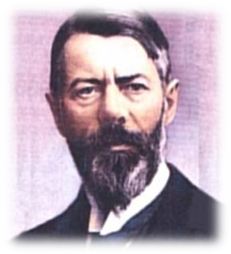
Remembering in particular that one of Weber’s caveats about traditional and emotional reasons for action is that they are highly unreflective – that they are not thought about – it is reasonable to say that it is reflexivity, for Weber, that guarantees the possibility of interpretation; and this is another reason why Weber treats traditional and emotional action as falling on the borders of the social.

Slide 95






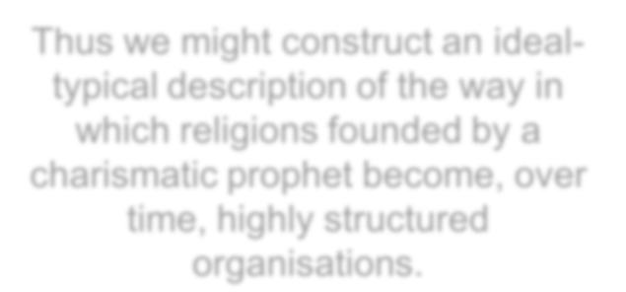



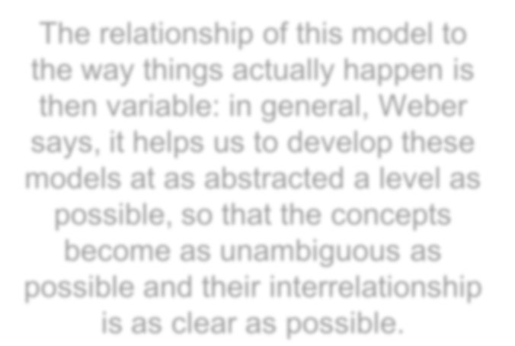





A major element in the method of Verstehen is what
Weber describes as “ideal types”.
These are models which describe “rules of the way things happen” in a way that makes sense to us.
Thus we might construct an ideal- typical description of the way in which religions founded by a charismatic prophet become, over time, highly structured organisations.
The relationship of this model to the way things actually happen is then variable: in general, Weber says, it helps us to develop these models at as abstracted a level as possible, so that the concepts become as unambiguous as possible and their interrelationship is as clear as possible.
These ideal types are then yardsticks against which we can measure what actually happened.

Slide 96
In other words, the ideal type is a description of a particular logic of process, or of a rational sequence of events in the sense of one where their sequence has a meaning.
Clearly, they will be far easier in the case of value- rational or goal-rational sequences, since an assumption continued custom tells us very little about the content of the custom, and assumptions that emotions follow particular sequences are very risky.
In other words, it is rationality itself – whether goal- rationality or value-rationality, that makes interpretation possible, on the basis of a shared and reflexive participation in the social world.

Slide 97
Beyond the specific case of rationalisation as a general process in modernity, then, rationality for Weber is a concept which bridges the gap between Sociology and its objects: Rationality, in either form, is present as a tendency within society, which may be approximated to a greater or lesser extent. The sociologist can use this tendential rationality to make more sense of the actual process of events.
Clearly, then, the more rationalised society becomes – the deeper into modernity we go – the easier the Sociologist’s task should become and the closer their interpretations should correspond with what actually happens.
As we shall see in subsequent lectures, this expectation has only been partially realised, if at all.
97

Slide 98
Ultra-modernism: The Structuralist Interpretation
Structuralism’s claim to be considered a form to
critical modernism – more tenuous.
While much structuralism claims to be “Marxist”, very often it appears rather more as an incorporation of Marxism into a rather more affirmative form of modernism.
This is particularly evident in the difficulties structuralist thought faces in coming to terms with reflexivity, as well as its consequent explicit or implicit flirtation with positivism.

Slide 99













Structuralist Theorists
Levi-Strauss
Louis Althusser

Slide 100


Differences between Levi-Strauss and Althusser: can certainly be said to be critical in terms of their political positions and the implications of some of their work, if not always in terms of reflexivity.
Structuralism intersects with the positivist and functionalist school deriving from Comte and Durkheim, which leads to Parsons’ “Structural- Functionalism”.
Critique of Althusser: The Poverty of Theory by E. P. Thomson

Slide 101






Distinction between “methodological individualist” approaches – individual as the starting-point for social theory – and “relational” approaches – which focus on the relations between individuals.
Marx: the relational emphasis derives from a conception of the individual as essentially social in nature.
Weber: what is relevant to the sociologist is action that is oriented towards the behaviour of others.
In both cases (Marx and Weber), structure arises out of social interaction, geared particularly towards labour in Marx and towards meaning in Weber.

Slide 102
In structuralism, relationship takes off and becomes fully independent: it is no longer human beings who relate with each other, but the fact of relationship which first creates the social and cultural individual out of an amorphous biological mass.
What does it imply?
We can only know the social, in other words the relational, and that “the individual” or “human nature” are therefore metaphysical concepts in the strict sense that we cannot know them.

Slide 103

For example, we cannot know X in her unique,
individual internal experience (even if we believe it
exists) – why? Because all we have available to
us is our social interaction with her – what she
says and what she does – this ultra-relationalism,
in other words, leads to what is known by the slogan of “the death of the subject”
Meaning, either the individual literally does not
exist because they are only created by social
interaction, and form simply an intersection
between different social relations; or the individual
is methodologically unknowable because we can only know the social.

Slide 104
The argument that the individual literally does not exist, that they are only the intersection of social relations or the “bearers” of social structure, is argued very strongly by Althusser, who sees our belief that we are individuals to be a psychological illusion.
Instead, Althusser argues, “the category of the subject … is the constitutive category of all ideology”.
Our illusory subjectivity generates ideology, and ideology reproduces our illusions of subjectivity.
104
Image courtesy: marx2mao.com

Slide 105


All that we can know, or all that exists, is the relational.
If all that we can know about is relations, then we can think about the way in which those relations interact with one another in a very detached, and often very formalistic approach.
We can also try and categorise the different types of relation which are possible; Weber’s four types of social action are a move in this direction.
Further, we have seen that despite his methodological individualism the concept of instrumental rationality in particular has a tendency to become dominant in his thinking.

Slide 106
What relationalism is likely to lead us to, in other words, is a categorisation of different types of relation and different levels of relation, and an account of society in terms of the interrelation of these different relations.
So, relational approaches tend towards this kind of categorisation, but they also tend to privilege intellectual consistency over empirical usefulness.

Slide 107
As we generate more of these concepts describing types
and levels of relations, we are going to want to make
them as consistent as possible with each other, for very valid intellectual reasons.
For equally valid reasons, we are likely to want to be able to generate all of them from as restricted a number of
basic concepts as possible; in other words, to generate
typologies of possible variations and interrelations of particular types of relations.
The net effect of all of this is that relational approaches
have a tendency towards what we can properly describe
as structuralist accounts, that is, accounts which derive
all of social reality from the operation and permutation of a limited number of basic concepts.

Slide 108


Because this core concept, from which our description of society is generated, is a highly intellectual one, this is
very likely to produce a form of philosophical idealism: a
theory which treats the (social) world as generated from ideas, and in this case from a single idea.
While there are dramatic differences in the content, the
structure of our account of society is likely to be very
similar whatever idea we start from; in some ways
Althusser’s account, not of actual modes of production but
of the idea of modes of production, and Levi-Strauss’
account of culture oriented around difference, produce quite similar ways of thinking.

Slide 109






Levi-Strauss performs two operations in his account of human culture:
Levi-Strauss employs a linguistic analogy to treat culture, not just as a system of relations, but as a system of symbolic relations, such as myths.
Using the same linguistic analogy, Levi-Strauss aims at a purely formal description of the various elements involved in particular myths; in other words, Levi-Strauss sets out to describe structure but not the content.

Slide 110
What this leads to is an argument that there is an objective meaning in human culture (revealed by structure) which is other than the subjective meaning (revealed by content).
Since, however, this objective meaning cannot be straightforwardly shown to be present in a particular myth once we bracket any question of the way people say they understand it or the contexts they tell it in, it has to be located within the unconscious. In other words, from a description of social relations we move to a description of the nature of the human psyche.
To complete this account, what Levi-Strauss claims to be the central feature of the human unconscious – a claim which he believes to be backed up by linguistics – is naturally enough identical with the concept he uses to analyse the objective meaning of the form of myths; this concept is that of difference or distinction. For Levi-Strauss, then, the end of the intellectual journey is a description of the social and in particular cultural world as a reflection of the supposed tendency of the human brain to divide things up.
110

Slide 111


If we assume that the social world can be derived from an idea – the idea of the capitalist mode of production, the idea of difference – then in principle there is no possible explanation of how social change arises.
The world is divided up like this because it is identical with the way the idea is organised; there is no reason why it should change.
Another possibility is to develop a typology of different possible types of society, so that change is simply change from one way of expressing the idea to another one. A more interesting and widely-used approach, however, is what is known as functional explanations.

Slide 112
Functional explanations?
Functional explanations are explanations of events in terms, not of their causes, but of their effects. For example, we might explain the fall of a government, not in terms of the events which led up to it, but in terms of what it led to. On the face of it this is simply unacceptable. The rules of logic do not allow us to reverse the flow of causality and say that an event A can be caused by an event B which has not yet happened. This form of explanation, which is known as teleological, can only make sense in one of two contexts.

Slide 113
One is, if event A is caused by a prior event alpha, which is
somebody’s intention with regard to the future. We can
certainly argue that a government fell because someone
wanted to form a different government and thus forced the collapse of the current government.
However, intention and effect are two different things: the
intention to bring about event B may not in fact be realised,
and our action in causing event A may have completely
different results. This is generally characterised as
“unintended consequences”, and it is clear from Weber’s
account of instrumental rationality as a method we adopt as a
means to a particular goal, but which then becomes an end in
itself. So an intentional explanation can only work where the
person with the intention is in fact not just all-powerful but has
total knowledge of the context of their action; in other words,
where they are God. Much mediaeval thought is teleological in
this sense: events are explained in terms of God’s plans for the future of the world.

Slide 114
Apart from intentional explanations, there is one other form of potentially valid explanation in terms of effects, which is the argument known as Functionalism; it is represented, for example, by the claim that such-and-such a thing happens “because the economy needs it” or “because of the interests of capital”
Note that this is quite different from an explanation in terms of the perceived needs of the economy (as seen by the government, by the electors or by individual managers). It is also different from a simple explanation in terms of compatibility: by definition, if a form of state is incompatible with a form of economic
organisation, they will not coexist – but this says
nothing about the reasons for their incompatibility or the mechanism which prevents their coexistence.

Slide 115
Strict functionalist explanations are based on an analogy to Darwinian evolutionary theory. This argues in terms of competition for survival in a situation of relative scarcity. Over immense periods of time, genetic mutations and variations will occur. Some of these will be functional for survival, in the sense that they will either enable the new individual to survive more effectively or to breed more effectively.
From the point of view of genetic reproduction, of course, what matters is that a plant or animal survives long enough to reproduce itself; the better its statistical chances of survival to this point, or the more successful it is at reproduction, the more individuals with this different genetic structure there will be. Over time, in other words, functional mutations will tend to reproduce themselves and spread; less functional mutations will survive less frequently (given competition for the same food etc.) or will be outclassed in terms of reproduction.

Slide 116
This argument does Not hold for social explanations, however, for three very important reasons.
First, it assumes fixed units such as individual
animals; in other words, its natural affinity is with a
radical methodological individualism which takes the
individual (or some other unit, perhaps the family or
the enterprise) not just as the starting-point but
effectively as the only reality: which does not
examine, for example, the social origins of the
individual's ways of thinking and definition of needs,
and which does not consider the possibility of
interaction between, for example, the individual and the family.

Slide 117
Secondly, it assumes that, whatever the unit is, it has a means of self- reproduction which is as exact and as stable as genetic transmission. Obviously enough, however, even when firms copy successful firms, they do not reproduce all features of the successful firms, and they cannot; all they do is import what they perceive to be the important features. So we can think of a general diffusion, for example of instrumental rationality, which is intentional in nature: people think that it is likely to be effective, and it happens that they are right. But we cannot say that this is a functional process.
The continuing history of Anglo-American interest in Japanese management methods is a sufficient example of this: “Japanese management” is not a single fixed entity like a collection of genes, but is transmitted as a series of what may be very differing assumptions about its key elements; just as importantly, Anglo-American workers and managers and Japanese workers and managers have different cultural backgrounds, so that the assumption that the firm is a unit which is not influenced by other social realities falls.

Slide 118
Thirdly, and perhaps most importantly, not only do we not have
straightforward units, and not only can they not reproduce themselves in a
simple fashion, but we have to say that the Darwinian argument of the
“survival of the fittest” can only be a metaphoric one when it is applied to society. We could not live like that, even if we felt it was desirable.
This can be seen very clearly at the level of “societies”: contemporary societies are not disputing a common living space; in fact the economically dominant societies are experiencing a population decline. More generally, conflict between contemporary societies is only very rarely expansionist; even where it is, it is generally a matter of the imposition of a new form of government, but not of the obliteration of the previously-existing society. Even where this is the case, as for example in
the population movements of the Migration period around the fall of the Roman Empire, “functionality” is a fairly ambiguous concept.
The societies which expanded into the declining Roman Empire were not
in general technologically superior to the Romans, or even necessarily
economically superior: indeed, their need to migrate may be seen as
evidence of the problems they experienced in maintaining their way of life
in the regions they originated from. Their superiority was partly
demographic, and partly military. In other words, “functionality” in these
terms is almost entirely destructive, and tells us very little about features of economic or social organisation.

Slide 119





How does radical relationalism lead to structuralism as a holistic account of society, and also indicate the well-known difficulty that structuralism has with explaining change?
The last feature of holism that is worth mentioning here is the concept of modernity expressed in structuralism.
While structuralism is strongly modernist in its approach, it does not treat modernity as a key term: it is itself modern, but it is not very interested in the specificity of the modern. There are obvious reasons for this: if society consists of a structure of relations deriving from a single key concept, it is hard to see how we can have dramatically different types of society.

Slide 120
This is a problem for Levi-Strauss, who derives the
organisation of culture from the biological structure of the unconscious brain, in other words from something which,
if it changes at all, does so over enormously long periods of time. Unsurprisingly, Levi-Strauss’ work, as was at the time the general practice among anthropologists, was largely devoted to the study of what were seen as “traditional” societies, and his concept of the modern is largely defined against these.
To an extent, it seems that he treats the modern as an
aberration, an unnatural separation of culture and nature,
and doomed to destruction for that reason. This may be
appealing as a political position, but it does not really
deal with the problem, and later structuralists have tried to show that modern culture can also be analysed in the terms that Levi-Strauss uses for “traditional” culture.
120

Slide 121

Althusser, by contrast, fits modernity into a static typology in which it is effectively simply one variant on a pattern. This derives from his version of Marxism, which replaces the crude version of economic determinism found in vulgar Marxism – the argument that everything else can simply be reduced to the economic – with a more sophisticated analysis of different levels of social life, including the economic, the political and the ideological. Each of these, for Althusser, can be described as “relatively autonomous”: in other words, it has a logic of its own, and cannot simply be reduced to the economic.

Slide 122

Thus, Althusser’s model of the social totality is that of a “decentred whole”. However, the economic is “determinant in the last instance”, in other words, it has the final say.
Since “the last instance never comes”, though, it is the interaction which is most important. Incidentally, this tension between “determination in the last instance” and the insistence that “the last instance never comes” is one of the major theoretical problems of Althusser’s holism.

Slide 123
Determination by the economic level expresses
itself primarily in the creation of these separate
levels and the prioritising of one or the other at different historical periods.
In other words, within a given mode of production,
it is the economic level which determines which level is dominant in a more immediate sense.
In feudalism, the political and ideological levels are
dominant; in capitalism, it is the economic level
itself which is dominant. In both cases, however,
the economic level is ultimately determinant; in
other words, it determines whether it will itself be dominant or whether some other level will be.

Slide 124
What does it imply? The economic (for these purposes) can be thought of in terms of the relations of ownership and control. In feudalism, the landlord owns the land, but the peasant controls their agricultural production; so the appropriation of the peasants’ surplus production by the nobility does not take place within the actual process of production, but as an effect of political or ideological structures which guarantee this transfer. In capitalism, on the other hand, the means of production are both owned and controlled by the capitalist; thus the appropriation of surplus value takes place within the process of production; the society is therefore said to be dominated by the economic. For Althusser, in other words, the difference between modern and other societies is that they represent different possible arrangements of the ownership - control situation.
Thus structuralism is unable to do anything very interesting with the idea of modernity, or indeed of social change more generally; it tends to reduce history either to contingent change
without any real meaning or to variations on a theme.
124

Slide 125




As with social change, so with social movements structuralism has remarkably little to contribute. This derives partly from the "death of the subject": if human agency is simply an illusion, then social movements can be explained either in terms of a functional contribution to social change (particularly in the case of the workers' movement) or, more commonly, as an ideological reaction against social change (particularly in the case of the new social movements).

Slide 126




This weakness derives partly from the interaction of theory with social movements themselves: a good example here is
Althusser. Althusser was a member of the French Communist
Party (PCF), which was perhaps the most immobile of the major
Communist Parties of western Europe, and an organisation
which could perhaps be described less as the political wing of
the workers’ movement than as the congealed wing of the
workers’ movement. French workers, throughout the 20th century, participated in a number of extremely radical actions –
general strikes, mass occupations of factories, the French
Resistance. At the same time, the Communists were by far the
most important working-class party, and indeed controlled the
main trade union federation and the greater part of the French Resistance.

Slide 127

However, the Party was not just a particularly orthodox and dogmatic one – by contrast with the Italian Communist Party, for example – it was also committed to the view, for most of its history, that radical change was simply not on the cards in France, partly for reasons of economic organisation but particularly because of the post-War situation where, on the one hand, it saw that a take-over of power would be likely to be crushed militarily by the Western Allies, and where, on the other hand, de Gaulle's semi-independent foreign policy, which led to the French armed forces, for example, not being under NATO control, was felt to be the best that could be hoped for.
The net result was that, in 1944-45, instead of turning the predominantly Communist Resistance into an attempt at taking power, as happened in countries like Yugoslavia, the Party accepted the political realities reflected by the Western Allies’ support for de Gaulle.

Slide 128

Similarly, in 1968, the Communist-dominated General Labour Confederation was instrumental in keeping the general strike under control, physically excluding student radicals from the factories where they might have undermined the Party’s position, and deradicalising the demands of the strike.
In France, in particular, 1968 was almost as much a rebellion
of the libertarian Left against the PCF as it was a challenge to the State. It is therefore not very surprising to find a Party philosopher keen to exclude any possibility that human agency could actually make a significant difference.

Slide 129
More generally, Althusser’s Structuralist Marxism can be seen as the logical development of one strand, but only one strand, of Marx's thinking.
The other approach, “Western Marxism” is more closely associated with social movements and activist parties; the kind of static Marxism practiced by Althusser is associated with parties who are either in power or who, for other reasons, are keen to minimise the possibility of large-scale social action which is not entirely under their control.

Slide 130




Structuralism is also of interest in terms of its notion of rationality, or, as it is more usually phrased, its claim to scientific status. Sometimes, this represents a pure positivism in terms of its research methods: the “social facts” are assumed to be out there, to be amenable to pure observation, and analysed on the model of natural
science. This kind of thing happens to any theory, and
it’s not a fault peculiar to structuralist practice. What is
rather more interesting is the rationalist version of science represented in much structuralist thought.
Image courtesy:1w3hp0s.org

Slide 131

We normally assume, when we hear the word “science” in English, that it refers to the natural sciences, or to methods which are based on those of the natural sciences.
What generally lies behind this is what we can loosely call an empiricist model of Science: Science as taking its starting-point from what is believed to be empirical reality, which literally means the reality available to the senses.
We can observe and experiment with this reality and attempt to build up valid generalisations about its behaviour.

Slide 132
In Sociology, this is what is normally meant by arguments about “Sociology as a Science”; what is commonly argued against it is that the reality we experience is already structured by ideas, such as the idea of time, and that social reality is already mediated by the forms of social interaction, such as language. In
each case, it is said, we cannot have a “pure” or unproblematic knowledge of reality.
This “empiricist” model of Science can, however, be contrasted with a “rationalist” model of Science, which argues that our knowledge of the world is, at least initially, a mental one rather than a real one; the implication being that, in one way or another, we can know reality through thought alone. This programme takes an enormous variety of forms, but two elements are fairly constant.

Slide 133
The first is that, at the end of the day, the most important thing is to think systematically and consistently.
The second is that, in general, we will tend to look for a
hidden reality underlying and explaining the observable world.
In explanation, these two emphases tend to take precedence over what we might call faithfulness to the world as observed or experienced. The latter is pressed into consistency, or the elements which do not fit are discarded. It is summarily “explained” in terms of what are claimed to be the “real”, underlying truths of the situation.

Slide 134
Many authors, in practice, combine elements of both these approaches, and it may be difficult not to: a fairly commonsense understanding of Social Theory, after all, would say that it aims both at internal consistency and at being an adequate account or explanation of the observed world.
But if the two of these are pulling in different directions
– if we claim, as does Levi-Strauss that the real world is unobservable, because it is unconscious, for example – then we will have to come down on one side or the other. Structuralism’s claim to be scientific generally comes down on the side of rationalism, in other words of aiming at being systematic and aiming to uncover a hidden reality.

Slide 135
This sense of the word “Science” is rather more widespread in Continental languages, which are capable
of describing Literary Criticism, Theology and so on as “Sciences”: what is meant is not that they represent an equivalent to Physics or Chemistry, but that they are systematic in approach.
If we add that the hidden reality which is aimed at or discovered is likely to be a mental one (given that the rationalist is explicitly taking their own thought as the starting-point or indeed the totality of all that is known), we can see the fit between this model of Scientific Rationalism and Structuralism as a systematic ordering of mental categories.

Slide 136

Althusser’s scientific rationalism is in some ways even more thorough-going than Levi-Strauss’: while he claims that there is a real world out there to which theory in some sense corresponds, scientific method has absolutely no need of empirical verification.
Martin Jay summarises Althusser’s conception of science very well: “Science, he claimed, operates on the level of conceptual production in which experimental verification plays no role; it is nonetheless materialist because it posits an ultimate congruence between thought objects and a real world. The raw material for scientific activity is provided by ideological conceptions of the world, the ‘facts’ that
positivists innocently take as the givens of existence” (Marxism and
Totality, p.401). In other words, scientific activity consists of the
progressive refining, rethinking and systematising of everyday (“ideological”) knowledge of the world; in Althusser’s own practice this takes the form of a scholastic project in which an ever-decreasing selection of Marx’s work is examined and rethought in order to produce what is presumably an ever-purer form of scientific knowledge.

Slide 137





Levi-Strauss, like many subsequent authors, argues for a close analogy between culture and language. Obviously this can mean virtually anything, depending on what we understand the nature of language to be, and Simon Clarke has argued that Levi-Strauss’ concept of language does not correspond closely with how linguists either then or now thought about it. One element of Levi-Strauss’ linguistic analogy is the argument that we can distinguish between the form and the content of a culture, or of a language. Just as a language (for Levi-Strauss) exists as a number of elements related in particular ways (form) which we can then use to express particular meanings (content), so culture is fundamentally a form, within which different contents can be expressed. In other words, while myths (for example) may express a particular meaning to the people who actually tell them or hear them, this meaning is expressed within and determined by the broader form of myths structured around difference. What Levi-Strauss deduces from this is a form of uncertainty principle.

Slide 138
Whereas in Physics, we may be in a position where we can measure light as a particle, or as a wave, but not as both simultaneously, in Anthropology or Sociology. For Levi-Strauss, we can know the content of a culture, or its form, but not both at the same time. In other words, we can think about the way a culture is structured, and indeed about the way culture as a whole is structured; this is like thinking about the syntactical structure of language. And like thinking about the syntax of a language, it cannot be done at the same time as thinking about the content or meaning. This means that we can study the structure of a culture with one method, or we can study the actual cultural meanings which are expressed with another method, but we cannot study both at the same time, because a study of actual meanings presupposes a knowledge of the structure with which those meanings are expressed. We can think about current meanings within our culture; we can stand back and think about our culture as a whole. We can even think about a foreign culture. But we cannot think about the meanings expressed within a foreign culture, because we lack the necessary knowledge of its structure.

Slide 139
There are a number of problems with this claim, which I will not disentangle for you; but it is worth thinking about as an unusual approach to the problem of reflexivity.

Slide 140


Society as Human Creation: Western Marxism
There is no agreed definition of “Western Marxism”. In the same way that the phrase “New Left” can be used to refer to radically different political developments, often depending largely on the speaker’s own point of view and whether they treat the phrase as a compliment or an insult, the phrase “Western Marxism” can be used to refer to very different sets of theories according to one’s preferences and purposes.
For my purposes, I am going to define Western Marxism negatively in terms of approaches which differ significantly from the major forms of Marxism that became institutionalised in the Leninist and social democratic parties of the pre-war period and positively in terms of reworkings of the Marxist tradition which emphasise the activist, humanist and emancipatory elements in his thought. This means locating Western Marxism in terms of agency rather than structure (in terms of the conventional distinction) or in terms of “critique” rather than “science” (in Alvin Gouldner’s terminology).
140

Slide 141
We can treat Structuralism and Western Marxism as the opposing developments of different emphases within classic modernism. One element of this can be seen in terms of the concept of determinism.
Both Marx and Weber emphasise the extent to which people's action is determined by their social situation; Marx's famous phrase for this is "Human beings make their own history, but not under conditions of their own choosing".

Slide 142
Structuralism develops the emphasis on the primary role of social relations to argue that the idea of agency is an
illusion. This can be described as a strong determinism, or perhaps more clearly as a variant of fatalism. A weak determinism would see determination as "setting limits
and exerting pressures"; in the Western Marxist tradition this setting of limits and exerting of pressure on human action is above all the result of the action of other human beings or of ourselves in the past.
In other words, if we take the idea of the determination of
human action by social structure as characteristic of classic modernism, we could say that structuralism collapses human action back into social structure, while Western Marxism tends to collapse social structure back into human action.

Slide 143

















Western Marxist Theorists
Lukacs
Touraine
Gramsci

Slide 144
The relevant writings of Lukacs and Gramsci date from the inter-war period, so they predate structuralism by a few decades. Lukacs was a Hungarian communist; his most important book for our purposes,
History and Class Consciousness, was written after his involvement
in the Hungarian revolution of 1919. Gramsci was involved in the workers’ council movement during the Turin strikes of the same
period. His theoretical reputation largely derives from his Prison
Notebooks, written in a deliberately elliptical fashion because of censorship and smuggled out of jail.
Both Lukacs and Gramsci share an experience of practical politics at a level which can be described in terms of the social totality, as well as an experience which leads them both to emphasise that social knowledge and social action are not separate forms of life.
Touraine’s life is a bit more prosaic; he is a French sociologist, but one whose research programme has led him into involvement with a broad range of social movements – from investigating the experience of car workers at Renault in the 1950s through involvement with the student movement in 1968 to research on Allende’s Chile and the anti-nuclear movement in France.

Slide 145


Thus, there is a common thread of
involvement with social movements and a refusal to separate theory from practice

Slide 146

Western Marxism shares with structuralism a common emphasis on holism or the concept of totality. This is formulated by Lukacs as “the all-pervasive supremacy of the
whole over the parts”. Thus both of the major developments of critical modernism reject methodological individualism in favour of a view of the social whole as essentially relational, although as we shall see the content of these relations differs dramatically.
In each case, it is this relational approach that enables us to think of a social whole. An example from the Western Marxist tradition would be the concept of class: this is seen as representing, not an individual fact (so that A is a shopkeeper and B is a peasant) but a relation (so that C stands in a relation of exploitation and domination of D).

Slide 147
As well as this strong relationalism, there is a radical extension of the category of “the social”. Like structuralism, or at least like Althusser’s structuralism, but unlike the classical modernism of Marx and Weber, Western Marxism tends to
treat “the social” as the primary or even the only reality. This is
clear in terms of the concept of human nature: the idea of a biologically fixed, universally present human nature is rejected as firmly by Gramsci as by Althusser (we have seen that Levi- Strauss does not take this approach).
Here again, the substance of Western Marxism’s alternative –
social agency – is radically different from that of structuralism. More broadly, the idea of nature as separate from and essentially different to society is rejected. For Lukacs, it is effectively unknowable; for Gramsci, nature is something that is effectively completely subordinated to society in the process of production. Similarly, both reject the idea of the unconscious as having an independent and pre-social nature. This is not just a rejection of the idea of the non-social; it is also bound up with a rejection of positivist and scientistic approaches to social reality and the insistence that we cannot claim to stand “outside of history”, to be an external observer of a fixed and given reality.

Slide 148

For Western Marxist authors, society is a human creation; more exactly, humanity is social humanity. “Human beings make their own history”, but not as isolated individuals. Human beings only appear as human beings in interaction with one another, that is, in social relations. These social relations, however, are not fixed and given, so that we could discuss them in terms of structures which define what appear to be individuals; rather, they are the results of collective creation and social conflict.

Slide 149




Thus whatever appears as natural, given, or fixed in society is the result of human action, but we do not recognise it as such. Lukacs introduces the term “Reification”
The process where the result of our actions appear to us as a quasi-natural “thing” (res), because we do not recognize its social origins or the process of creation that goes into its formation.
This concept of reification links in to some of Marx’s discussion of what is translated into English as “alienation”, but it does not give economic production, interaction with external nature, the same central role it has in much of Marx’s writing.
In Western Marxism, then, what appear as structures are simply
the products of human action, or, even more simply, a form of
human action which has taken on a life of its own and now appears quasi-natural.

Slide 150






to characterise the view of society is that of “expressive totality”. The social whole, the totality, is seen simply as the self- expression of the social subject, a self- expression and self-creation which we only partially recognise as such.
150

Slide 151

Western Marxism recognises that an abstract description of
the subject of this process of the expressive creation of
society as being simply “humanity” would be both ahistorical
(in the sense of not recognising the changing nature of this
process over time) and metaphysical, because identifying
the social creator with all of social humanity, even at a single point in time, makes it difficult if not impossible to point to the specific social locations of this creation. While all members of society are seen as involved in this creation – because they are involved with each other, they do not do
so equally, or consensually, except perhaps in a future
communist society.

Slide 152
Therefore, Western Marxists argue that the social actor, the creative subject, is not social humanity as a whole
but its parts, in particular social classes. Social classes,
then, are placed at the centre of the Western Marxist
theory of society; social structure arises out of social conflict.
This is as true for the creation of institutions for the purpose of exploitation and domination (industrial organisation, the state) as it is for the creation of institutions by which the dominated and exploited aim to overcome both domination and exploitation and
create a new social order. This may explain why
Western Marxism has traditionally generated both
analyses of the mechanisms of state domination,
cultural manipulation and so on and analyses of the
emancipatory power of action to resist and transcend them.

Slide 153






Two points: (i) The first is to remind you of Marx’s distinction between “class-in-itself”, in other words class situation as created by economic situations, and “class-for-itself”, in other words a class’s self-creation of itself as a class through political organisation and the development of class consciousness.
In Western Marxism, it is the latter (“class-for-itself”) which receives most attention, because it is here that the creative and relational aspects of class can be seen most clearly: class organisation and class culture are clearly creative, and equally clearly, at least in the case of the workers’ movement, they are not self-sufficient but are formed in conflict with the capitalist class.
Touraine, indeed, argues that there is no class without class consciousness, in other words that the concept of class is meaningless unless it relates to social action.

Slide 154

(ii) Gramsci develops these issues in his well-known discussion of “hegemony”
The essential point he makes is that the power of a ruling class does not reside simply in its control of physical force: power does not simply “come out of the barrel of a gun”.
One of the central locations of conflict, beside the workplace conflict and the conflict over control of the state, is therefore a cultural one: capitalist domination also rests on a particular form of “common sense”, a particular form of everyday culture, as well as what to academics are the more obvious issues of the production of cultural commodities.

Slide 155


The workers’ movement, he argues, needs to work not just towards seizing power in the State and control of the workplace, but also towards the creation of a new cultural hegemony. What does it imply?
Transforming the way in which we think about the world, recreating culture in a new form with a new content.

Slide 156
One example of what is meant by this can be seen in the Italian context: Gramsci argues that the peasants, in
particular of the South, accept the present order of things not so much out of economic interest or because of repression but because their everyday mode of social
organisation places them in a position of dependence on local notables and because their religious culture equally subordinates them to the dominant social groups.
The task of the workers’ movement, he argues, is to build a
new alliance with the peasantry involving the
transformation of their everyday modes of cultural and social organisation. For this reason he placed a particular
stress on the development of what he called “organic”
rather than “traditional” intellectuals – the growth of a new
working-class intelligentsia which would be able to speak to the working class not just in terms of economic interest or political strategy but also to draw on working-class culture and language.

Slide 157

Thus Western Marxism takes the consciousness of ordinary people - their class identity, culture, language and so on - as seriously as it does their activity; indeed, it tends to argue that the two cannot be separated. There is no class without class consciousness for Touraine; for Gramsci, the discussion of “culture” is at the same time a discussion of modes of social and political organisation. Consistently, Western Marxism does not believe in theorising as a pure activity: abstract philosophising, free of all social relations, is neither desirable nor possible. In both cases, then, knowledge and action are seen as ultimately the same thing. We do not act without thinking, but our thought is itself related to practical activity. Gramsci expresses this point of view in a number of famous aphorisms; perhaps the most creative part of his thinking on the subject is his redefinition of intellectual activity as including both theoretical and organising activity. This, of course, relates not just to Communist Party activists but also to “traditional” intellectuals – local notables such as the village doctor, the priest, or the schoolteacher – and the organising and theoretical activity of civil servants or managers.

Slide 158







So Western Marxism can be described both cognitively and normatively as a philosophy of “praxis”, or the unity of thought and action.
It is asserted: (a) that this is what happens in everyday life; and (b) we should realise this and take it into account, for example while we are theorising.
However, there is obviously more to the issue than that,
or it would not make sense to claim that the results of our thought and action appear to us as things, external, structures.

Slide 159
Thus Gramsci, for example, argues that while "everyone is an intellectual" (in other words, theorises and organises on an everyday level), "not everybody has the social function of an intellectual" (in other words, not everyone devotes themselves to this thinking and organising.
In other words, the division of mental and manual labour, diagnosed by Marx and carried to its extremes in the Taylorist model of production, means that this initial unity is at the very least severely distorted.
On a more general level, the reality of class conflict and class culture means that the social actors, the conflicting class movements of the rulers and the ruled, cannot fully grasp the social totality, but are restricted to a partial knowledge of it. Thus the reason we do not grasp the expressive totality of society as such is that the agent is not the whole of social humanity but is, in fact, the conflicting parts of that humanity.

Slide 160

Synthesising Modernity and Social Theory
Immanuel Wallerstein – American Sociologist, historical social scientist and world-systems analyst
First became interested in world affairs as a teenager in NY city, and was particularly interested in the anti-colonial movement in India at the time (1943-47).
Began as an expert of post-colonial African affairs, which he selected as the focus of his studies after an international youth conference in 1959.
Wallerstein’s publications were almost exclusively devoted to this until the early 1970s, when he began to distinguish himself as a historian and theorist of the global capitalist economy on a macroscopic level.
His early criticism of global capitalism and championship of “anti-systemic movements” have recently made him a gray eminence with the anti-globalisation movement within and outside the academic community, along with Noam Chomsky and Pierre Bourdieu.
160

Slide 161


Wallerstein’s most important work, The Modern World-System, appeared in 3 volumes in 1974, 1980 and 1989.
In The Modern World-System, Wallerstein draws on three intellectual influences.

Slide 162
















Wallerstein’s Works: Three Major Intellectual Influences
Marx, whom Wallerstein follows in emphasising underlying economic factors and their dominance over ideological factors in global politics, and whose economic thinking he has adopted with such ideas as the dichotomy between capital and labour, the staged view of world economic development through stages such as feudalism and capitalism, belief in the accumulation of capital, dialecic and more.
Dependency theory, most obviously its concepts of “core” and “periphery”
French historian Fernand Braudel, who had described the development and political implications of existence networks of economic exchange in the European world between 1400 and 1800.

Slide 163
And – presumably – the practical experience and
impressions gained from his own work regarding
post-colonial Africa.
Wallerstein has also stated that a major influence
on his work was the “world revolution” of 1968.
Wallerstein was on the faculty of Columbia
University at the time of student uprising there,
and participated in a faculty committee that
attempted to resolve the dispute.
Wallerstein has argued in several works that this
revolution marked the end of “liberalism” as a
viable ideology in the modern world-system.

Slide 164

One aspect of his work that Wallerstein certainly deserves credit for is his anticipating the growing importance of the North-South Conflict at a time when the main world conflict was the Cold War.
Wallerstein rejects the notion of a “Third World”,
claiming there is only one world connected by a
complex network of economic exchange relationships – that is, a “world-economy” or “world-system”, in which the “dichotomy of capital and labour”, and the endless “accumulation of capital” by competing agents account for frictions. This approach is known as the World Systems Theory.

Slide 165
Wallerstein locates the origin of the "modern world-system" in 16th-century Western Europe and the Americas. An initially only slight advance in capital accumulation in Britain, the Dutch Republic and France, due to specific political circumstances at the end of the period of feudalism, set in motion a process of gradual expansion. As a result only one global network, or system of economic exchange, exists today. By the 19th century, virtually every area on earth was incorporated into the capitalist world-economy.
The capitalist world-system is, however, far from homogeneous in cultural, political and economic terms — instead characterized by fundamental differences in civilizational development, accumulation of political power and capital. Contrary to affirmative theories of modernisation and capitalism, Wallerstein does not conceive of these differences as mere residues or irregularities that can and will be overcome as the system as a whole evolves.

Slide 166
Much more, a lasting division of the world in core, semi-periphery and periphery is an inherent feature of the world-system. Areas which have so far remained outside the reach of the world-system, enter it at the stage of 'periphery'.
There is a fundamental and institutionally stabilized 'division of labor' between core and periphery: While the core has a high level of technological development and manufactures complex products, the role of the periphery is to supply raw materials, agricultural products and cheap labor for the expanding agents of the core.

Slide 167
Economic exchange between core and periphery takes place on unequal terms: the periphery is forced to sell its products at low prices, but has to buy the core's products at comparatively high prices. This unequal state which, once established, tends to stabilize itself due to inherent, quasi-deterministic constraints.
The statuses of core and periphery are not mutually exclusive and fixed to certain geographic areas; instead, they are relative to each other and shifting: there is a zone called 'semi-periphery', which acts as a periphery to the core, and a core to the periphery. At the end of the 20th century, this zone would comprise, e.g., Eastern Europe, China, Brazil or Mexico. Peripheral and core zones can also co-exist very closely in the same geographic area.

Slide 168

One effect of the expansion of the world-system is the continuing commodification of things, including human labor.
Natural resources, land, labor and human relationships are gradually being stripped of their "intrinsic" value and turned into commodities in a market which dictates their exchange value.

Slide 169
In the last two decades, Wallerstein has increasingly focused on the intellectual foundations of the modern world system, the 'structures of knowledge' defined by the disciplinary division between Sociology, Anthropology, Political Science, Economics and the Humanities, and the pursuit of universal theories of human behavior. Wallerstein regards the structures of knowledge as Eurocentric. In critiquing them, he has been highly influenced by the 'new sciences' of theorists like Ilya Prigogine.
He has also argued, consistently since 1980, that the United States is a 'hegemon in decline'. He was often mocked for making this claim during the 90s, but since the Iraq war this argument has become more widespread. He has also consistently argued that the modern world system has reached its endpoint. He believes that the next 50 years will be a period of chaotic instability which will result in a new system, one which may be more or less egalitarian than the present one.

Slide 170
Wallerstein's theory has also provoked harsh criticism, not only from neo-liberal or conservative circles, but even some historians who have averred that some of his assertions may be historically incorrect.
As well, some critics suggest that Wallerstein tends to neglect the cultural dimension, reducing it to what some call "official" ideologies of states, which can then easily be revealed as mere agencies of economic interest.
Nevertheless, his analytical approach, along with that of associated theorists such as Andre Gunder Frank, Terence Hopkins, Samir Amin, Christopher Chase-Dunn and Giovanni Arrighi, has made a significant impact and established an institutional base devoted to the general approach. It has also attracted strong interest from the anti-globalisation movement.
170

Slide 171
Capitalist World-System
This definition of Wallerstein follows Dependency Theory,
which intended to combine the developments of the
different societies since the 16th century in different regions
into one collective development.
The main characteristic of Wallerstein's definition is the
development of a global division of labour, including the
existence of independent political units (in this case, states)
at the same time.
There is no political centre, compared to global empires like
the Roman Empire; instead the capitalist world system is
integrated on the world market. It is divided into core, semi-
periphery and periphery, and is ruled by the capitalist
method of production. The ideal type of market is
capitalism.

Slide 172

Core/Periphery
Defines the difference between developed countries and developing countries, characterized
e.g. by power or wealth. The core stands refers to developed countries, and the periphery is a synonym for the dependent developing countries. The main reason for the position of the developed countries is economic power.

Slide 173

Semi-periphery
Defines states that are located between core and periphery, they benefit from the periphery through unequal exchange relations. At the same time, the core benefits from the semi- periphery through unequal exchange relations.

Slide 174
For Wallerstein, some 50 years ago, “modern” had two clear connotations.
First, “modern” signified the most advanced technology. The term was situated in a conceptual framework of the presumed endlessness of technological progress, and therefore of constant innovation. This modernity was in consequence a fleeting modernity – what is modern today will be outdated tomorrow.
A second major connotation to the concept of modern, one that was more oppositional than affirmative. One could characterise this other connotation less as forward-looking than as militant (and also self- satisfied), less material than ideological. To be modern signified to be anti- medieval, in an antinomy in which the concept “medieval” incarnated narrow-mindedness, dogmatism, and above all the constraints of authority.

Slide 175
Presumptive triumph of human freedom against the forces of evil and ignorance – a trajectory as progressive as that of technological advance. But it was not a triumph of humanity over nature; it was a triumph of humanity over itself, or over those with privilege. Its path was not one of intellectual discovery but of social conflict.
This modernity was not the modernity of technology; it was rather the modernity of liberation, of substantive democracy (the rule of the people as opposed to that of the aristocracy) of human fulfilment. This modernity was not a fleeting modernity, but an eternal modernity. Once achieved, it was never to be yielded.

Slide 176
The two stories, the two discourses, the two quests, the two modernities were quite different, even contrary one to the other. They were also, however, historically deeply intertwined one with the other, such that there has resulted deep confusion, uncertain results, and much disappointment and disillusionment.
This symbiotic pair has formed the central cultural contradiction of our modern world-system, the system of historical capitalism. And this contradiction has never been as acute as it is today, leading to moral as well as to institutional crisis.

Slide 177
Wallerstein traces the history of this confusing symbiosis of the two modernities – the modernity of technology and the modernity of liberation – over the history of our modern world-system.
Wallerstein divides the analysis of the modern world-system into three parts:
The 300-350 years that run between the origins of our modern world- system in the middle of the 15th century to the end of the 18th century;
The 19th and most of the 20th centuries, or to use two symbolic dates for this second period, the era from 1789 to 1968;
The post-1968 period.

Slide 178
The modern world-system has never been fully comfortable with the idea of modernity, but for different reasons in each of the three periods.
During the first period, only part of the globe (primarily most of Europe and the Americas) constituted this historical system, which we may call a capitalist world-economy.
Why capitalist world-economy? For three defining features:
There existed a single axial division of labour within its boundaries, with a polarization between core-like and peripheral economic activities;
The principal political structures, the states, were linked together within and constrained by an interstate system whose boundaries matched those of the axial division of labour;
Those who pursued the ceaseless accumulation of capital prevailed in the middle run over those who did not.

Slide 179
Nonetheless, the geoculture of this capitalist world- economy was not yet firmly in place in the first period. Indeed, this was a period in which, for the parts of the world located within the capitalist world-economy, there were no clear geocultural norms.
There existed no social consensus, even a minimal one, about such fundamental issues as whether the states should be secular; in whom the moral location of sovereignty was invested; the legitimacy of partial corporate autonomy for intellectuals; or the social permissibility of multiple religions.

Slide 180
If cultural contradiction there was, it was that the capitalist world-economy was functioning economically and politically within a framework that lacked the necessary geoculture to sustain it and reinforce it. The overall system was thus maladapted to its own dynamic thrusts. It may be thought of as uncoordinated, or as struggling against itself.
The continuing dilemma of the system was geocultural. It required a major adjustment if the capitalist world-economy were to thrive and expand in the way its internal logic required.
180

Slide 181
The second period (1789 – 1968): It was the French Revolution that forced the issue, not merely for France but for the modern world-system as a whole.
The French Revolution was not an isolated event. It was bounded (preceded and succeeded) by the decolonization of the Americas – the settler decolonizations of British North America, Hispanic America and Brazil; the slave revolution of Haiti; and the abortive Native American uprisings such as Tupac Amaru in Peru.
The French Revolution connected with and stimulated struggles for liberation of various kinds and nascent nationalisms throughout Europe and around its edges – from Ireland to Russia, from Spain to Egypt.

Slide 182
Above all, the French Revolution made it apparent, in some ways for the first time, the modernity of technology and the modernity of liberation were not at all identical.
Indeed, it might be said that those who wanted primarily the modernity of technology suddenly took fright at the strength of the advocates of the modernity of liberation.

Slide 183
In the 19th-century core zones of the capitalist world- economy, liberal ideology translated itself into three principal political objectives – suffrage, the welfare state and national identity – the combination of which liberals hoped would achieve the objective of appeasing the “dangerous classes” while nonetheless ensuring the modernity of technology.
The great ideology of the 19th century, socialism, accepted the inevitability and desirability of progress. Socialists were suspicious of top-down reform. They were impatient for the full benefits of modernity – the modernity of technology to be sure, but even more the modernity of liberation. They suspected quite correctly, that the liberals intended “liberalism” to be limited both in its scope of application and in the persons to whom it was intended to apply.

Slide 184
The third phase (post-1968 period): The world revolution of 1968 flamed up and then subsided, or rather had a profound impact on the geoculture. For 1968 shook the dominance of the liberal ideology in the geoculture of the world-system.
It thereby reopened the questions that the triumph of liberalism in the 19th century had closed out or relegated to the margins of public debate.
The dismantling of socialism in the erstwhile USSR and the East European landscape (1989-91) requires critical examination.
The modernity of technology had transformed the world social structure in ways that threatened to destabilize the social and economic underpinnings of the capitalist world-economy. And the ideological history of the world-system was then a memory that affected the current ability of the dominant strata to maintain political stability in the world- system.

Slide 185
For Wallerstein, we must engage in an enormous worldwide multilogue, for the solutions are by no means evident. And those who wish to continue the present under the guises are very powerful.
The end of what modernity?
Let it be the end of false modernity, and the onset, for the first time, of a true modernity of liberation.

Slide 186

Synthesising Modernity and Social Theory: Anthony Giddens
Modernity | Postmodernism
Social fragmentation and dispersal | Epistemological crisis
A dialectic of dispersal and globalisation | Centrifugal tendencies and dislocation
The self as active and reflexive | The self as dissolved and dismembered
Globalisation will produce more universality and so systematic knowledge is still possible | Contextual, historical truths only
A dialectic between powerlessness and empowerment | Powerlessness
Daily life as a complex of reactions to abstract systems | Daily life replaced by abstract systems
Co-ordinated political action is both possible and necessary | Political action is now impossible because of contextualty
Postmodernity means moving beyond modernity [to socialism and a good life] | Postmodernity as the end of epistemology, the individual, and ethics

Slide 187
These themes are illustrated through discussions of various kinds of social forces, micro-politics and so on, although there is still a curiously abstract level to the discussion, especially about active or reflexive selves.
The implications for Sociology are drawn. Sociology is part of the reflexivity of modernity, but it needs to be reformed to take into account the space/time manipulations and dimensions of late modernity.
For example, we need to look beyond the nation state as a model of society. Processes of differentiation that have been identified by earlier theorists need to be replaced with concepts of embedding/disembedding, which would widen into an account of the whole subsequent dialectic operating between risk and trust, faceless and face-to-face commitments.

Slide 188
The 'problem of order is one of time - space distanciation', in that time and space are ordered in modernity to connect presence and absence.
These space - times separations produce disembedding [of traditional forms of relationships], as standard and abstract dimensions of space and time come to order and rationalise activities in the place of local contexts. Examples include the use of a timetable to co-ordinate going on a journey by car and plane. Such organisations also clearly involve reflexive accounts of past activities. Disembedding both ‘lifts out “social relations from local contexts of interaction”, and restructures them “across indefinite spans of time and space”’. This is a better way of describing what has happened compared to concepts of social differentiation [in Parsons, say or Weber ] which are evolutionist.
Disembedding mechanisms require the creation of symbolic tokens, especially money, defined as mechanisms to control time and space. They also lead to the establishment of expert systems. These disembed further, because they provide abstract guarantees of expectations across time and space: these impersonal tests and public forms further ‘stretch’ social systems. They also imply a different kind of trust.

Slide 189
Trust is defined fairly extensively. To summarise, it arises from the lack of full information; it connotes reliability in the face of contingency; it operates as a link between faith and confidence; it involves principles rather than relying on the morality of others, developing ‘confidence in the reliability of a person or system’. It takes on a more calculative form in modernity.
Everyday life is more reflexive, so that many people already know something of more specialist areas such as official statistics on divorce, for example and ‘It would not be at all unusual to find a coroner who had read Durkheim’. Everyday life becomes both sociologised and psychologised.
Anti-foundationalism [in post-modernism] is dismissed as ‘inchoate’, if pushed to appear as a theory, or a mere description of a normal part of modernity -- 'Modernity coming to understand itself', 'fuller understanding of reflexivity inherent in modernity itself'. Giddens claims that it expresses an awareness which is widespread, 'anxieties which press in on every one’.

Slide 190
Modernity can thus be described as the greater and greater use of disembedding mechanisms to organise social life. However, there is also considerable re embedding, involving the pinning down of disembedding mechanisms to local contexts again. This happens when relations of trust are also formed by facework commitments, and as a more generalised trust in abstract systems develops, even where these involve faceless commitments. Goffman's work is cited here on the relationships which develop between strangers and how they are managed. Giddens also tells us that the personal and impersonal are deeply intertwined in everyday life.
Relations of trust are always ambivalent. Confidence is needed because there is a fundamental ignorance of the social world, but this means that trust is largely a matter of making pragmatic connections, based on past experiences. However, there is another dimension to it, based on a general 'ontological security'. This arises in early childhood as a result of definite child rearing practices – and some child psychology is summarised, such as Erikson.
190

Slide 191

Traditional and modern cultures can be contrasted in terms of how they create environments of trust and risk. Giddens’ shows how the traditional social bonds such as kinship community and religion can be seen as devices to organise environments of trust, while the characteristic environments of modernity are seen as personal relationships, abstract systems, future - oriented counterfactual thinking, and a perception of threats, not from nature, war, or the gods, but from the greater reflexivity of modernity, industrialised war, and personal meaninglessness [the chance is missed here, perhaps, to sketch of the dangers of excessive reflexivity?

Slide 192
The adaptive mechanisms to these perceptions of risk and threat are common to both expert and lay people. Expertise rapidly runs into the limits of the predictability of the world, and this can produce a pragmatic acceptance, an interest in surviving.
As Lasch has suggested, this can produce and numbness and deep anxiety. An alternative coping mechanism is sustained optimism, based on faith in reason or in God.
A third possibility is cynical pessimism, where people cope with risks by using black humour, the celebration of anachronism and so on, as a way of coping with pessimism as such.
Finally, there is the possibility of radical political engagement in various social movements. Giddens seems to have missed out retreatism and 'innovation', the development of illegal activity as in criminal careers. He has added sustained optimism and cynical pessimism.

Slide 193

Trust is crucial to modern life, and it is intertwined with the growth of globalisation. Trust on a more personal level is best seen as a project, something to be worked at, involving a 'mutual process of self disclosure'. Giddens focuses on erotic involvement here, especially the 'romantic love complex'. He also takes on Lasch's gloomier view of an increasing manipulation and powerlessness, the result of a growing 'menacing appearance of the contemporary world' [This seems reminiscent of Bauman's insistence that only pure or 'we-' relations offer hope in modernity].
Globalisation leads to displacement of the old embedding mechanisms and a possible re embedding, in a whole dialectic of displacement and re embedding, intimacy and impersonality, expertise and reappropriations, privatism and engagement.

Slide 194

[Referring to Habermas], expert systems do not colonise life worlds, but engage in a dialectic so that changes in every day life also affect disembedding mechanisms, and 'technical expertise is continually re appropriated by lay agents'. Thus expertise continually 'filters back' into the life world [certainly a welcome attempt to modernise the concept of the life world in Habermas?].
Finally, modernity institutionalises doubt. We have not developed a new post modernist phase, but rather a complex meaning of presence and absence -- 'not primarily an expression of cultural fragmentation or of the dissolution of the subject into a "world of signs"'. Rather, the experience of modernity arises from a ‘simultaneous transformation of subjectivity and global social organisation against a troubling backdrop of high consequence risks’.

Slide 195

Synthesising Modernity and Social Theory: Jürgen Habermas
Jürgen Habermas in the tradition of critical theory and pragmatism
The Structural Transformation of the Public Sphere
Habermas’s work focuses on the foundations of social theory and epistemology, the analysis of advanced capitalistic societies and democracy, the rule of law in a critical social-evolutionary context, and contemporary politics – particularly German politics.
Habermas’s theoretical system is devoted to revealing the possibility of reason, emancipation, and rational- critical communication latent in modern institutions and in the human capacity to deliberate and pursue rational interests.

Slide 196

Habermas is known for his work on the concept of modernity, particularly with respect to the discussions of “rationalization” originally set forth by Weber.
Whilst influenced by American pragmatism, structural functionalism, and even poststructuralism, many of the central tenets of Habermas’ thought remain broadly Marxist in nature.

Slide 197
Habermas has constructed a comprehensive framework of social theory and philosophy drawing on a number of intellectual traditions:
the German Philosophical Thought of Immanuel Kant, Friedrich Schelling, G.W.F. Hegel, Wilhelm Dilthey, Edmund Husserl, and Hans-Georg Gadamer
the Marxian Tradition – both the theory of Karl Marx himself as well as the critical neo-Marxian theory of the Frankfurt School, i.e. Max Horkheimer, Theodor Adorno, and Herbert Marcuse
the Sociological Theories of Max Weber, Émile Durkheim, and George Herbert Mead
the Linguistic Philosophy and Speech Act Theories of Ludwig Wittgenstein, J.L. Austin, P.F. Strawson, Stephen Toulmin and John Searle
the Developmental Psychology of Jean Piaget and Lawrence Kohlberg
the American Pragmatist Tradition of Charles Sanders Peirce and John Dewey
the Sociological Social Systems Theory of Talcott Parsons and Niklas Luhmann
Neo-Kantian Thought

Slide 198

Habermas considers his major contribution to be the development of the concept and theory of communicative reason or communicative rationality, which distinguishes itself from the rationalist tradition by locating rationality in structures of interpersonal linguistic communication rather than in the structure of either the cosmos or the knowing subject.
This social theory advances the goals of human emancipation, while maintaining an inclusive universalist moral framework.

Slide 199
This framework rests on the argument called universal pragmatics - that all speech acts have an inherent telos (the Greek word for “end”) — the goal of mutual understanding, and that human beings possess the communicative competence to bring about such understanding.
Habermas built the framework out of the speech-act philosophy of Ludwig Wittgenstein, J.L. Austin, and John Searle, the sociological theory of the interactional constitution of mind and self of George Herbert Mead, the theories of moral development of Jean Piaget and Lawrence Kohlberg, and the discourse ethics of his Heidelberg colleague Karl-Otto Apel.

Slide 200

Habermas’s works resonate within the traditions of Kant and the Enlightenment and of democratic socialism through his emphasis on the potential for transforming the world and arriving at a more humane, just, and egalitarian society through the realization of the human potential for reason, in part through discourse ethics.
While Habermas has stated that the Enlightenment is an “unfinished project”, he argues it should be corrected and complemented, not discarded. In this he distances himself from the Frankfurt School, criticising it, as well as much of postmodernist thought, for excessive pessimism, misdirected radicalism and exaggerations.

Slide 201
Within Sociology, Habermas’s major contribution was the development of a comprehensive theory of societal
evolution and modernisation focusing on the difference between communicative rationality and rationalisation on the one hand and strategic/instrumental rationality and rationalisation on the other.
This includes a critique from a communicative standpoint of the differentiation-based theory of social systems developed by Niklas Luhmann, a student of Talcott Parsons.
His defence of modernity and civil society has been a source of inspiration to others, and is considered a major philosophical alternative to the varieties of post- structuralism. He has also offered an influential analysis of late capitalism.

Slide 202

Habermas perceives the rationalisation, humanisation, and
democratisation of society in terms of the institutionalisation
of the potential for rationality that is inherent in the
communicative competence that is unique to the human species.
Habermas contends that communicative competence has
developed through the course of evolution, but in
contemporary society it is often suppressed or weakened
by the way in which major domains of social life, such as
the market, the state, and organisations, have been given
over to or taken over by strategic/instrumental rationality,
so that the logic of the system supplants that of the life world.

Slide 203
Reconstructive Science:
Habermas introduces the concept of “Reconstructive Science” with a double purpose:
to place the “general theory of society” between philosophy and social science; and
to re-establish the rift between the “great theorisation” and the “empirical research”.
Image courtesy: amazon.c2o0m3

Slide 204


Slide 205
The model of “Rational Reconstructions” represents the main thread of the surveys about the “Structures” of the world of life (“Culture”, “Society” and “Personality”) and their respective “Functions” (Cultural Reproductions, Social Integrations and Socialisation).
For this purpose, the dialectics between “Symbolic Representation” of “the structures subordinated to all worlds of life” (“internal relationships”) and the “material reproduction” of the social systems in their complex (“external relationships” between social systems and environment) has to be considered.

Slide 206

This model finds an application, above all, in the “theory of the social evolution”, starting from the reconstruction of the necessary conditions for a phylogeny of the socio-cultural life forms (the “hominisation”) until an analysis of the development of “social formations”, which Habermas subdivides into primitive, traditional, modern and contemporary formations.

Slide 207
Key points
Attempts to formalise the model of “reconstruction of the logic of development” of “social formations” through the
differentiation between vital world and social systems (and, within them, through the “rationalisation of the world of life” and the “growth in complexity of the social systems”)
Tries to offer some methodological clarifications about the “explanation of the dynamics” of “historical processes” and, in particular, about the “theoretical meaning” of the evolutional theory’s propositions.
Even if Habermas considers that the “ex-post rational reconstructions” and “the models system/environment” cannot have a complete “historiographical application”, these certainly act as a general premise in the argumentative structure of the “historical explanation”.

Slide 208
The Public Sphere
In The Structural Transformation of the Public Sphere, Habermas developed the influential concept of the public sphere, which emerged in the 18th century in Europe as a space of critical discussion, open to all, where private people came together to form a public whose “public reason” would work as a check on state power.
Image courtesy: mitpress.mit.edu208

Slide 209

209

Slide 210

Habermas argues that prior to the 18th century,
European culture had been dominated by a
“Representational” culture, where one party
sought to “Represent” itself on its audience by overwhelming its subjects.
As an example of “Representational” culture,
Habermas argued that Louis XIV’s Palace of
Versailles was meant to show the greatness of
the French state and its King by overpowering the senses of visitors to the Palace.
219

Slide 211
Habermas identifies “representational” culture as corresponding to the feudal stage of development according to Marxist theory, arguing that the coming of the capitalist stage of development marked the appearance of Öffentlichkeit (the public sphere).
In the culture characterized by the public sphere, there occurred a public space outside of the control by the state, where individuals exchanged views and knowledge.

Slide 212


Slide 213
In Habermas’s view, the growth in newspapers, journals, reading clubs, Masonic lodges, and coffee-houses in 18th century Europe, all in different ways, marked the gradual replacement of “representational” culture with Öffentlichkeit culture.
Habermas argued that the essential characteristic of the Öffentlichkeit culture was its “critical” nature.

Slide 214
Unlike “representational” culture where only one party was active and the other passive, the Öffentlichkeit culture was characterised by a dialogue as individuals either met in conversation, or exchanged views via the print media.
Habermas maintains that as Britain was the most liberal country in Europe, the culture of the public sphere emerged there first around 1700, and the growth of Öffentlichkeit culture took place over most of the 18th century in Continental Europe.

Slide 215

In his view, the French Revolution was in large part caused by the collapse of “representational” culture, and its replacement by Öffentlichkeit culture.
Though Habermas’s main concern in The Structural Transformation of the Public Sphere was to expose what he regarded as the deceptive nature of free institutions in the West, his book had a major effect on the historiography of the French Revolution.

Slide 216

According to Habermas, a variety of factors resulted in the eventual decay of the public sphere, including the growth of a commercial mass media, which turned the critical public into a passive consumer public; and the welfare state, which merged the state with society so thoroughly that the public sphere was squeezed out.
It also turned the “public sphere” into a site of self- interested contestation for the resources of the state rather than a space for the development of a public- minded rational consensus.

Slide 217
In his magnum opus Theory of Communicative Action (1981), Habermas criticised the one-sided process of modernization led by forces of economic and administrative rationalisation.
Habermas traces the growing intervention of formal systems in our everyday lives as parallel to development of the welfare state, corporate capitalism and the culture of mass consumption.

Slide 218



Slide 219
These reinforcing trends rationalise widening areas of public life, submitting them to a generalising logic of efficiency and control.
As routinised political parties and interest groups substitute for participatory democracy, society is increasingly administered at a level remote from input of citizens.

Slide 220
As a result, boundaries between public and private, the individual and society, the system and the lifeworld are deteriorating.
Democratic public life only thrives where institutions enable citizens to debate matters of public importance. He describes an ideal type of “ideal speech situation”, where actors are equally endowed with the capacities of discourse, recognise each other’s basic social equality and speech is undistorted by ideology or misrecognition.
In this version of the consensus theory of truth Habermas maintains that truth is what would be agreed upon in an ideal speech situation.
220

Slide 221
Habermas has expressed optimism about the possibility of the revival of the public sphere.
He discerns a hope for the future in the new era of political community that transcends the nation-state based on ethnic and cultural likeness for one based on the equal rights and obligations of legally vested citizens.
This deliberative theory of democracy requires a political community which can collectively define its political will and implement it as policy at the level of the legislative system.
This political system requires an activist public sphere, where matters of common interest and political issues can be discussed, and the force of public opinion can influence the decision-making process.

Slide 222

Habermas versus Postmodernists
Habermas offered some early criticisms in an essay, ‘Modernity versus Postmodernity’ (1981), which has achieved wide recognition.
In this essay, Habermas raises the issue of whether, in light of the failures of the twentieth century, we
“should try to hold on to the intentions of the
Enlightenment, feeble as they may be, or should we
declare the entire project of modernity a lost cause?” Habermas refuses to give up on the possibility of a rational, “scientific” understanding of the life-world.

Slide 223
Habermas has several main criticisms of postmodernism
First, the postmodernists are equivocal about whether they are producing serious theory or literature.
Second, Habermas feels that the postmodernists are animated by normative sentiments but the nature of those sentiments is concealed from the reader.
Third, Habermas accuses postmodernism of being a totalizing perspective that fails “to differentiate phenomena and practices that occur within modern society”.
Lastly, Habermas asserts that postmodernists ignore that which Habermas finds absolutely central - namely, everyday life and its practices.

Slide 224















Deconstructing Modernity: The Feminist Challenge
Modernity may be interrogated by differing dimensions.
Feminism poses key challenge to critical modernism.
The question is whether the two are compatible or opposed.
“Intellectual Politics”
Encounter among feminism, postmodernism and critical modernism

Slide 225

Social movements
Analogy between Marxism and feminism:
interaction between “movement” intellectuals and academic intellectuals;
recomposition within the academy;
characteristics from social movements – concern for agency / ideology, experience / reflexivity.

Slide 226

“First-wave” feminism
“Second-wave” feminism
Feminist writers devote little time to the movement as such and the feminist theory of social movements is limited.
Most interest is on recovering history of “first- wave” feminism rather than understanding the contemporary women’s movement in sociological terms.

Slide 227
This disinterest is shared with other “identity politics” movements and contrasts with Marxist emphasis on analysis of present movement;
Stronger focus on “enemy” agency (“backlash”, ideology, patriarchy, etc.)
Related to political / rhetorical strategy of arguing for necessary link between structure (patriarchy) – interests (women’s) – demands (feminism) – action (movement) and reluctance to examine conditions of this;
Related also to interests of 1970s Marxism in ideology and structure (Althusser) but not agency.

Slide 228

Empirical question of the compatibility / identity of movements (versus class, ethnic, etc. movements) is raised, as is the question of the nature of (women’s, men’s identity).

Slide 229
Reflexivity and Rationality
“Lived experience” a la Thompson / Williams;
Concern to take women's knowledge seriously
Relation to theoretical / organisation skills developed within women’s movement.
Critique of Leninist model of deduced and imposed knowledge.
Especially critique of “speaking for” women.
Oral history, life-story, biographical methodology.
Concern to broaden area of “relevant knowledge”, refusal of cognitive splits (analytic / normative, rational / emotional, etc.)

Slide 230
Legitimation of, for example, sexuality, housework as “serious subjects”.
Cognitive splits seen as legitimating exclusion of women’s experience and concerns.
Male Left (= critical modernism) seen as colluding in this domination by political economy and instrumental rationality.
Political shift from “instrumentally rational” hierarchical logics to organisation as aim in itself – issue of organisation of “academic mode of production” (Stanley).
Doubt re “speaking for”: if knowledge was universal, could be articulated, and could be deduced from general principles, anyone could speak for anyone else. But it does not work in practice.
230

Slide 231
Holism, etc.
Marxism / feminism debate, derived from early interaction in second-wave feminism.
Liberal feminism not discussed here as clearly affirmative modernist in approach (modernisation as progress; absence of reflexivity; uncritical reliance on state agency, etc)
Idea of patriarchy in radical and Marxist / socialist feminism -> Patriarchy / capitalism debate.
Patriarchy as systematic domination and exploitation of women by men.

Slide 232
Limits of patriarchy concept when used to exclude critical modernist discourse (as in radical feminism):
difficulty in thinking about nature of paid work rather than distribution of positions within it;
difficulty in explaining conflicts within patriarchal state / politics;
difficulty in explaining change within unchanged patriarchy;
difficulty in agreeing on nature of problem (biological? psychological?)

Slide 233
Attempts at Integration:
Dual-systems theory (Walby): interaction / interarticulation of capitalism and patriarchy (hence shift private -> public patriarchy);
Capitalism typically seen as patriarchal but as changing the nature of patriarchal mechanisms of domination and exploitation;
Very fruitful as empirical hypothesis.

Slide 234
Periodisation Issue:
Patriarchy seen as antecedent to and more general than capitalism, yet capitalism clearly modifies patriarchy (changing gender divisions of labour, private / public issue, family changes,. etc.)
Suggest: this is false problem. "Patriarchy" is at higher level than "capitalism" and corresponds in fact to "class society" in Marx:
both dominate known history;
both can be seen (a la Raymond Williams!) as continuously interrelated;
can be thought of in "loose" terms as domination and exploitation without turning what are historically specific modes of gender and class formation into an eternal structure.

Slide 235
We can then look at (a) capitalist patriarchy and (b) interaction of shifts within capitalism and patriarchy (private
-> public shift).
NB: need also to consider idea that changes in patriarchal
modes of domination / exploitation lead to shifts in capitalism as well; points to need for more dynamic and agency-oriented theories of patriarchy?
This area generates fruitful empirical hypotheses for historical/sociological analysis of institutions (Abbott and Wallace, Walby), runs risk of too much contingency / description and inability to grasp contemporary capitalist patriarchy as coherent structure or as "agency system" a la Touraine. Walby especially often reads like collection of descriptions of 90s Britain. What is often missing is a theoretical account of what generates and renews patriarchal relations in their most general sense.

Slide 236
Unified systems accounts:
General agreement by now of inadequacy of "Marxist feminism" (patriarchy as subset of capitalism): especially historical difficulties (patriarchy comes first) and limited range of issues for which this helps.
Most important idea: domestic labour as "reproduction of real life" (Engels) and hence thinkable as constituent element of capitalism.

Slide 237
Difficulties:
This doesn’t account for other patriarchies;
Difference between needs of capital for reproduction of labour power (functionalist account) and needs of individual capitalists for cheap female labour.

Slide 238
Empirical value especially in pointing to impact of housework, childcare, emotional support and especially childbearing / childcare nexus (simultaneously a possible answer to "why women"? question, implying transferral of "natural" childbearing to "natural" childcare functions, and something with a directly demonstrable impact on women's life-chances in contemporary society.)
NB however collusion of male workers in imposing "private patriarchy" even against capitalist interests; "family wage"; threat to working class wages and organisation levels. Suggests contradiction between women's and (male) workers' interests & hence between movements.

Slide 239
Unified socialist feminist theories (as against "Marxist feminism") don't subordinate patriarchy to capitalism but reconceptualise both.
Early version: Firestone (normally presented as radical feminist but here seen as expanding idea of production and reproduction of real life). Firestone draws on Engeis' Origin of the Family ... Generally reckoned to be failure because of her biological determinism, but brave and pioneering attempt at reconceptualising everything.
Later: Young and Jaggar (expansions of "division of labour" and "alienation”).

Slide 240
Especially alienation account broadens idea of exploitation / domination and resolves sociological issues around agency / structure in a very helpful way: it avoids reification of limited aspects and moments of capitalism as constitutive of all "class society".
Claim / aim of unified theory: to integrate analysis of "production and reproduction of real life", domination and exploitation; typically also integration of analysis of meaning and psychoanalysis, literary theory, politics, etc. Key question: is it tenable?

Slide 241
Finally:
Some of difficulties of agreement in 1970s feminism (and some of promise of unified socialist feminism) relates to academic specialisation / reification: political economy, biological deteminism, literary criticism, psychoanalysis, etc. The specialisation of these fields and generation of narrow concepts tends to lose hold on the totality of lived experience.
Cue cultural studies a la Williams, Thompson, Foucault; Angela McRobbie’s Defence of “looseness”.

Slide 242

Deconstructing Modernity: Towards Cultural Studies
History of social thought as a differentiation:
Philosophy / History split (Greeks)
birth of modern Political Science (Machiavelli)
Economics / Anthropology in modern senses (enlightenment)
Each simultaneously addresses itself to specialised category of human experience and attempts to project this as account of the whole.

Slide 243
Series of attempts to reverse this process: Marx and Weber are classic examples. Both link politics, economy and culture (as class consciousness / ideology in Marx; status / religion in Weber).
In (later) critical versions the emphasis has generally been on political economy as the central link; culture gets reduced to ideology / status symbols, etc. (In structural functionalism the reverse happens and things are abstracted to the point where "values" appear as an explanation of everything.) Critical political economy is then itself specialised to accounts of the institutions of the formal economy and of the state.

Slide 244

“Cultural studies” joins feminism in the attempt to:
(1) broaden the categories used,
(2) include culture without reductionism;
(3) thus generate a more adequate holism.

Slide 245



Let us look at 2 influential sources for cultural studies:
EP Thompson / Raymond Williams - socialist humanism
Foucault – radical post-structuralism
Very different accounts, but surprising similarities…
Marginal status:
perspectives more than theories
Haven’t founded coherent schools
but have taught people to think and work in new ways

Slide 246
Thompson / Williams
Derived from Western Marxist tradition but
informed by (lower middle-class / working class)
background and grassroots political activism post-CP.
Refusal of Base / Superstructure model Arguments:
separated “levels” cannot be isolated like this
Politics and Economics are also cultural (EPT), culture is material (RW)
central importance of “whole way of life” / “whole way of struggle”.

Slide 247
Culture [i.e. social movements]
EPT:
class culture (development of “class consciousness” idea)
close attention to “anthropology” of popular culture (language and ritual, needs and expectations, formation of resistant popular agency)
experience as junction concept between domination / exploitation and formation of political / cultural resistance (class as relation or as experience).
RW:
culture in lived experience: place, community, kinship, etc.
close analysis of formation of cultural production as material institutions and not simply disembodied “authors”
recovery of class experience within language.

Slide 248
Theorising [i.e. holism]
EPT:
distrust of overly sophisticated abstractions as “exercise in intellectual closure”
attention to dialectic between experience and thought
Poverty of Theory: capitalist relations as “kernel” of society.
RW:
distrust of “specialisation”, aim for looser but more encompassing concepts (loose but coherent)
Towards 2000: from mode of production to way of life.

Slide 249



Slide 250
Rationality / Reflexivity:
EPT:
artisan model of “determination” by material (data) of theory etc; interaction, “working with” the material;
sharp refusal of inductive analytic reasoning in abstraction from lived experience of subjects;
(implicit) identification with subjects and relevance to present- day struggles;
(loosely) dialectic rationality - not aiming at or claiming neutrality but interacting with “material” and using it in present- day context.
Strategy of “circularity” between material and concepts in
Poverty of Theory.
Question of whether this is a search for “truth” or (more likely) a search for (present-day) “meaning” in history.
250

Slide 251
RW:
Frankfurt School-influenced critique of “dominative mode”: attitude to world, others, self as “raw material”.
Need to connect with “lived experience” of emotion, etc. Refusal of “specialised” rationality
(Implicit) reliance on “fully human” nature of writer
Synthetic rationality / reflexivity in refusal of separation between private emotion and public analysis, private feeling / culture and public economy / politics.
“Humanism of both”: radical use of language of “fully- developed human being” and of human needs / meaning versus systems of domination and exploitation. Human commonality and (class) difference. Analysis implicitly grounded in shared humanity and shared (class) struggle.

Slide 252

Michel Foucault
Developed from structuralist tradition (contrast to EPT / RW), but unusual among poststructuralists in retention of analysis of power, institutions etc. as against purely literary or philosophical approach. Multiplicity of theories rather than single coherent Theory. Both Jay and Habermas treat dialogue between Foucault and critical modernism as a central one. Shares with RW / EPT dissolution of isolation of separate "levels" of society; for MF this is via an analysis of power.
Traditional model of power (incl. liberal and Marxist theories), for MF:
power is possessed by someone;
power is derived from a central source;
power is primarily repressive.

Slide 253
Foucault:
"Power is exercised": it is a relation. This derived from structuralist relationalism vs. subject-orientation of Western Marxism.
"Power is analysed as coming from the bottom up": post- structuralist refusal of single unified totality ex state, ideology, economy, etc. Instead multiplicity of power relations & no distinction between "levels".
NB (holism):
No escape from power relations (challenge to Habermas' "ideal speech situation"): human relations are always involved with coercive power. Hence this is not a liberal pluralism (with private retreats) but an all-encompassing multiplicity.
(social movements)
Power includes possibility of resistance and struggle; it's never totally one- dimensional.

Slide 254
3. Power as constitutive of subjectivity etc. through power / knowledge. NB contrast to RW's use of Frankfurt School model of dominative / exploitative approach (instrumental rationality) which assumes original human nature a la Marx's philosophical anthropology.
Shifting types of power. Discipline and punish: from dramatic spectacle (public mutilation / execution) to micro-level but all- present intervention (prison: surveillance / interventions to reform prisoner).
Link power / knowledge: power in prison system relates to ability to view / hear prisoners and to "know" them as individuals constituted for example, via a psychological history - case sheet held by psychologist who makes recommendations as to treatment -> psychology, criminology, etc.
Spread outwards via e.g. examination -> pedagogical knowledge; surveys -> social sciences. Hence human sciences bound up with spread of surveillance as discipline / disciplines.

Slide 255


Slide 256
This suggests a characterisation of modernity as "disciplinary society" but MF refuses this kind of total analysis: the reasons for its spread are seen as contingent.
Ditto sexuality: Victorian era e.g. not one of repression of sexuality so much as of its creation via spread of (psychological, social-scientific, pedagogical, criminological etc.) "knowledge" about sex.
Issue of homosexuality (MF activist): people's self-identification with their sexuality as central element of personality relates to this form of knowledge.
Hence MF offers radical critique of rationality as mode of domination. He offers not so much an alternative as a greater awareness of the ambiguous nature of rationality. It is not really possible to stand outside it, reflexivity consists in distancing ourselves from it and criticising it, being aware of its dangers. As against the model of 'global intellectuality" ex some meta-Theory MF offers situated / specific intellectual and political interventions.

Slide 257
Common points (EPT / RW / MF)
Refusal of “separate levels” (political, economic, cultural) of analysis, culture not residual or reduced to economics / pol. ideology but key and omnipresent mediating term.
NB need to distinguish analysis of political, economic,
cultural institutions from pol., econ., cult. relations; most social relations and institutions involve a mix of power, value and meaning (pol. econ., cult.)
Rejection of inductive Concepts ex (structuralist-type) Theory for ground-up thinking; looser categories.
Skepsis re rationality as mode of domination, but no alternative.
Radicalisation of this position -> postmodernism

Slide 258
Deconstructing Modernity: The Postmodernist Challenge
Introduction: the postmodernist phenomenon
Postmodernism as recent (mid-1980s) buzz-word but then extended backwards to cover developments in literature and literary criticism, philosophy, visual art, architecture etc. since 1950s + especially from 1970s on.
Orig. ex French post-structuralist philosophy + its encounter with Anglo-American lit. crit. + cultural studies; now governing set of ideas in at least some contexts.
Not coherent body of thought but series of ideas, combined or separated in differing ways by different authors.

Slide 259
Three central ideas:
“Culture” as produced and received is postmodern in form and content (postmodernist vs. modernist aesthetics);
“Society” (esp. political economy) can now be seen as having moved into a “postmodern” condition (postmodernity vs. modernity);
For a variety of reasons, the “metanarratives” which legitimate the knowledge of modern intellectuals can no longer be sustained (postmodernism vs. “the enlightenment project”).

Slide 260
Postmodernist aesthetics
Largely irrelevant for our purposes: related to argument about “modernist aesthetics”.
* Dominant version is related to a traditionalist view of “culture” as
“cultural” artefacts (esp. literature, but also extended eg to film, television, advertisements, etc.); sometimes (but by no means
always) taken one step further into discussion of reception of these
by audience. More commonly involves projection of analysis of “text” onto assumptions about audience as “constituted” by text, rather than as using text for their own purposes (Weber: “elective affinity”).
Against this, Angela McRobbie (Postmodernism and popular
culture) defends a more sociologically-informed analysis which
broadens out notion of cultural production and reception as practices and attempts to recover the everyday meanings e.g. of clothes shopping.
Arguments about production of “postmodern” culture, however,
lead into discussion on “postmodernity” as historical condition; arguments about reception of “postmodern” culture – or the modes of perception revealed or created by it – lead into discussion on “postmodernism” as an attack on “modern” forms of knowledge and their assumptions and legitimation.
260

Slide 261


Postmodernity as a historical condition
This is effectively one construction placed on a series of observations about contemporary trends which have also been deployed in relation to now- discounted theories about post-industrialism, as well as in relation to arguments about disorganised capitalism (Lash and Urry), radicalised modernity (Giddens), etc.

Slide 262

The argument can be presented as a series of contrasts:
Against "Fordist" production methods (based on economies of scale) there is a shift to "post-Fordist" organisation of production (with increased "flexibility", subcontracting, small-batch production, etc) with an increasingly important role for knowledge (managerial skill, scientific expertise, information technology, etc.);
Against an economy based on material production for arguably real needs there is a shift to the production of symbols, cultural artefacts, etc.;
Against the post-WWII welfare state compromise there is a shift to a neo-conservatism based on the decline of collective bargaining and the weakening of the nation-state;

Slide 263
Against "old social movements" of modernity (esp. class movements) there is the formation of "new social movements" which undermine the holistic claims of the workers' movement;
Against the high culture / low culture division of modernist culture there is a general shift to a fragmented and pluralist "postmodern" cultural configuration;
There is a shift from socialisation + determination by social relations to individualisation & interaction above all with the "spectacle";
There is a shift in the social construction of time and space or in their meanings (history, place / community / identity).

Slide 264



This list also points to the wider claims being made by arguments about the "postmodern condition":
(a) They can be taken to pull the carpet away from the Marxist analysis of capitalism as a mode of economic organisation; from a strategy oriented around the working class as the central agent of social transformation; and from a hope for greater "substantive rationality" through education, socialisation, science, increased rational control of the environment, etc. What is generally missed in this kind of argument is that it is a very limited kind of Marxism (very often one belonging to "postmodernist" authors themselves, in an earlier incarnation) which is being taken to stand for the whole of Marxism. In particular, a 1970s mix of Lenin, Trotsky and Althusser is being taken to represent the totality of the meanings and practices both of Marxist authors and of the workers' movement.

Slide 265
(b) They can be taken as relating to a further development within capitalism itself, in which case the challenge is to reformulate a form of historical materialism which is not contradicted by these developments and dispenses with the "local" analyses of Marx, Lenin, etc. for the sake of retaining the more general elements of historical materialism. This is the line taken by two of the central responses to the "postmodern challenge":
Frederic Jameson, Postmodernism, or the cultural logic of late capitalism; David Harvey, The condition of postmodernity.
Both of these authors take the line that the "postmodernists" are pointing to something of relevance (and Jameson in particular finds the concept of "postmodernism" a useful one in cultural analysis), but do not accept that these points need to mean a retreat from Marxism

Slide 266





Slide 267

(c) This approach, along with the "Giddens / Habermas" argument which sees contemporary society in terms e.g. of "radicalised modernity", has strong empirical support within this kind of argument. For example, "the working class" is not a homogenous whole, but something which has periodically been disintegrated by shifts within capitalism (since the 18th century) and which has periodically reconstituted itself; similarly, the "welfare state" / "neo- corporatist" compromise can be seen simply as a moment within the longer development of capitalism. Even the apparent shift in emphasis from the production of "material goods" to the production of "knowledge" has to be severely qualified. Most of the relevant arguments were made 20 years ago in Krishan Kumar's polemic against theories of "post-industrialism".

Slide 268
To make a couple of obvious points:
Industrialism as a technique has been organised around the appropriation of knowledge from the workers and its redeployment at least since Ford and Taylor in the 1920s; this is not restricted to what we think of as "industry", but has been exported to become the dominant mode of organisation both of agricultural activity and of "services“
It has to be remembered that there was an agricultural / merchant modernity and an agricultural / merchant capitalism prior to the development of industrial production in the secondary sector.

Slide 269
In other words, the claim that "postmodernity" is a specific historical condition which displaces modernity has generally been met, in particular within sociology, by pointing out that what is singled out as "modernity" is in fact a very limited and specific part of modernity, so that what is now happening is better understood as another stage in the longer history of modernity. I'll be going into this response more closely in the next couple of lectures. For the moment, it's enough to point out that most sociologists do not accept the claim that modernity is over, while many would accept the proposition that "postmodernism" does represent a new cultural configuration linked to a a new phase in the development of modernity as a social configuration. This is most commonly presented in a Marxist form, but a Weberian version of the argument is certainly possible, and has been made both by Giddens and by Bryan Turner.

Slide 270
Bryan Turner
Anthony Giddens
270

Slide 271
The central challenge to critical modernism, then, is neither the argument about a postmodern aesthetics (which many modernists are happy to accept) nor the argument about postmodernity as a historical condition (which is taken to be a misunderstanding of developments that can be adequately accounted for within the terms of critical modernism). It relates to the ontological claims of postmodernist philosophy.

Slide 272
Postmodernism as Ontology / Epistemology
In some ways, the claims of postmodernists to identify a
specific historical condition which could be described as postmodern are incoherent in that they contradict some of the most important claims of postmodernism as a philosophy.
The identification of postmodernity as a historical condition implies, firstly, a notion of a general and underlying social reality, and secondly the claim that this reality can be described in holistic terms, in other words as forming a whole bounded in time and probably in space. Postmodernist philosophy, in fact, forms a kind of anti-ontology or anti-social theory, in which both the idea of a holistic theory and the idea that this could have a rational relationship to some social totality are rejected.

Slide 273
In some authors this contradiction is resolved, more or less convincingly: Lyotard's account of The postmodern condition, for example, explicitly uses the idea of a shift towards information technology as a useful hypothesis whose ultimate truth-status is, apparently, irrelevant. His key argument is that these apparent shifts in social reality undermine the possibility of belief in the modernist view of the world and push us into post-modernism. The difficulty here is that if this is in fact what is happening, it does not enable us to distinguish which of these two views of the world is in fact more valid; and while Lyotard himself might claim not to find this problematic, there is quite a strong implication in postmodernist philosophy that its anti-theory is more valid than the previous, modernist theory it critiques.

Slide 274

If this is true, however, not only does it not need legitimation by a historical account of how we have arrived at this new and more valid perspective, but that perspective itself would prevent us from offering such an account. In other words, it may well be that postmodernism is necessarily faced with a choice between treating postmodern philosophy as simply an effect of postmodernity as a historical condition and effectively ditching the historical account in favour of the philosophy; and this latter approach seems rather more promising.
Jean-François Lyotard

Slide 275

Postmodern philosophy is effectively an extension and "radicalisation" of poststructuralist thought, sharing a number of features, notably:
The rejection of holistic theories and the idea of totality in favour of theories of multiplicity;
The rejection of the idea of the unitary subject in favour of theories of heterogeneity, of intersecting "language games" (Lyotard), etc.

Slide 276
An idea which is not unchallenged in post-structuralism but becomes an orthodoxy in post-modernism is the primacy of the "text" (however defined) over "the social". We saw that Foucault retains an interest in institutional analysis and the organisation of social relations; in post-modernist writing (with some exceptions, like Angela McRobbie), "texts" (which can include things like television advertisements or everyday conversations) are taken to be the sole constituent of reality, so that the assumption of a deep social reality underlying these everyday surfaces is rejected. These surfaces, in one version of things, are reality; and the idea that there is anything behind them is akin to the belief in God. This is of course only really sustainable on the basis of a rejection of determination and causality, so that the "texts" of the everyday conversations carried out at the stock exchange or of administrative regulations are treated as having no greater influence over events than the "texts" of conversations in the pub or of the latest movie.

Slide 277
This is in effect a version of the poststructuralist emphasis on the "signifier" as opposed to the "signified", or in other words of language rather than the subject-objects of language which are human beings talking about their relations with one another. In the Foucauldian approach, the separation between signifier and signified is effectively denied, so that administrative regulations, for example, are seen as being at one and the same time statements about reality and statements which constitute a particular reality. This approach has some strong methodological support, although it restricts us to an examination of only some aspects of social reality and is likely eventually to prevent us from making necessary distinctions such as the distinction between ideology (what is said) and practice (what is done) or from identifying patterns of determination. Other poststructuralists, along with postmodernists, tend to deny the existence of the "signified" at all; and this is the meaning of the emphasis on
surface appearances and the denial of any deep realities.

Slide 278
These surfaces themselves are then interrogated within a particular set of assumptions - notably, their status as "texts" - which derive at a greater or lesser remove from literary criticism and literary philosophy. This dramatically "logocentric" approach, which has no place for meanings or practices other than those embodied in language, points to one of the central origins of poststructuralist and postmodernist thinking, which is, I think, to be found within a particular intellectual history. For much of the twentieth century - in particular, under the influence of Marxism, but more generally under the impact of historical and sociological thought, the knowledge of literary intellectuals has been devalued in practice. At the same time, literature has retained a high degree of status (in Max Weber's terminology); in part precisely because of its luxury status: the legitimation of "Art" as non-instrumental activity and of a literary education as the hallmark of those who could afford not only "an education", but also an education which was not
immediately professional or vocational in nature.

Slide 279

This situation has of course been challenged by dissident literary intellectuals, such as Raymond Williams, but it has nevertheless remained dominant. Thus literary intellectuals have had a high degree of status but a declining amount of power in society as a whole - and a declining intellectual credibility in intellectual circles. In effect, their knowledge has been dramatically devalued over the past half-century by comparison with historical and sociological knowledge: much of the subtext of the arguments, not just around post-structuralism and post- modernism, but also around, for example, cultural studies or feminist writing, is about literary intellectuals attempting to revalorise their knowledge as a substitute for sociological knowledge, and sociologists attempting to keep them out. In other words, it is about what counts as valid knowledge. If the social world only consists of "texts", literary knowledge has priority. If the social world has a reality of its own, it does not.
Raymond Williams
279

Slide 280

The most characteristic element of post-modernism, however, is what has become known as the scepticism towards "metanarratives" or "grand narratives", in other words, the accounts of reality which are claimed to underpin modernist thinking, whether it is affirmative or critical. This is often formulated as a direct or indirect polemic against Habermas' arguments about the "Enlightenment project" as something which remains to be completed, against the irrationality of the dominant structures of society, and the "two discourses of modernity", an idea he uses to contrast the dominant version of affirmative modernity with the "counter-discourse" of critical modernity.
Habermas
280

Slide 281
Lyotard phrases the argument in this way: Modernist thought depends on one of two myths or meta-narratives. The "myth of truth" represents the dominant, technical-scientific approach, or, in the terms of this course, affirmative modernism. It has to do with the assumption of an unproblematic objective and external truth which can be discovered by the scientist and whose progressive discovery will enable a greater and greater control of the world and hence an improvement of living standards, etc. The "myth of liberation" is clearly related to critical modernism, or to Habermas's "counter-discourse of the Enlightenment": it has to do with the ideas of emancipation from our social condition, with the development of critical and reflexive thought, and with social movements as the agency of our self-emancipation. Both, of course, relate to some idea of the social whole; in both, this relationship is rational in form.

Slide 282

The attack on these "meta-narratives" then makes use of the different points I have mentioned earlier: a rejection of holism, a rejection of the subject in whose search for truth or emancipation these narratives are grounded (in terms of reflexivity and in terms of their legitimation), a rejection of the idea of hidden depths to be understood. What we are then presented with is a mixture of anti- realism, anti-rationalism, and Nietzschian relativism. I want to explain each one of these points very briefly.

Slide 283
Firstly, anti-realism: realism is a technical term, implying the assumption of the existence of a deeper reality than the surface reality we are immediately presented with. As we have seen, postmodernism rejects the idea, for example, of capitalism as an underlying reality which we can know either eventually or indirectly, and replaces this by an ontology of surfaces, in which what you see is what you get. Clearly, if this is accepted, Sociology (if it survives at all) has to give up any claims at analysis or discovery in favour either of simple description or of formalist games.

Slide 284

Secondly, anti-rationalism: the attack on rationalism mixes elements of Foucault's charge that humanist ideals of reason are in fact the governing ideologies of a disciplinary society with the Frankfurt School's scepticism towards "instrumental reason" of all kinds, as well as with more general philosophical statements about the failure of reason. In effect, what is said is that logic is (a) internally inconsistent in mathematical terms and (b) cannot legitimate itself. (b) is probably true by definition: if internal legitimations are taken as circular, and external legitimations are only accepted if they are fully consistent with the system of thought under discussion, we are effectively looking for an external justification which is also an internal one, and we will get nowhere. (a) is perhaps more serious, but it is important to stress that it only applies if - and this is a very big if - we treat reason or rationality as identical with a particular set of logical and mathematical operations, in other words if we assume that rationality exists in the abstract, separate from any social grounding.
Michel Foucault

Slide 285

Thirdly, however, these charges are brought together in a return to Nietzche's relativism. To make a crass over-simplification, Nietzche was already arguing, at the end of the nineteenth century, that the idea of an absolute truth was a myth, and that intellectual conflict was in effect a power struggle to determine which way of viewing the world should prevail. This is relativist insofar as it rejects the idea of any priority of one way of thinking over another; it treats rationality as just one imperfect way of thinking about things among others; and it rejects the idea of an external reality to which we can appeal. Something like this is suggested in at least some postmodernist writing, and there has been something of a "return to Nietzsche" in philosophy. What is perhaps missed in the rush to use Nietzsche against critical modernism is that Weber's critical modernism was already built on this kind of scepticism about rationality. Just as post-modernism tends to squash "Marxism" (or "modernity") into boxes which leave out a lot of their real complexity, so some of the complexity of other critical modernisms gets ignored.

Slide 286
Feminism and postmodernism as a test case
The last thing I want to mention is the encounter between feminism and poststructuralism / postmodernism, which is by any standards one of the key encounters in contemporary intellectual politics: the issue being whether the two form part of a common assault on the tenets of both critical and affirmative modernism, or whether it transpires that the two are incompatible and that feminism is effectively a renewal and transformation of critical modernism. There is by now a large literature on this subject; books such as Barrett and Phillips' Destabilising theory or Linda Nicholson's Feminism / postmodernism are obvious places to start, but the issue is a central one in much if not most contemporary feminist theory and cultural studies.

Slide 287



Slide 288
Initially, a large number of feminists were attracted by the project of poststructuralism / postmodernism, for a number of reasons:
It legitimated the idea of a multiplicity of relations of power rather than of a single, dominant totality;
This meant that issues of gender, class and ethnicity could be taken separately, rather than requiring, for example, a subordination of the women's movement to the struggle against capitalism or a subordination of black women's struggles to a single struggle against patriarchy, etc. [Category of "difference"];
The "anti-essentialist" argument that the category "women" was a cultural construct rather than an ontological reality related to earlier arguments about the social nature of gender;
The delegitimation of "reason" was simultaneously a delegitimation of a particular kind of knowledge within which women had been either excluded or subsumed into a single "universal" account;
For essentially contingent reasons, women were rather more likely to possess literary-critical knowledge than sociological knowledge, although the field of literary criticism as a whole is dominated by men.

Slide 289
However, there has been an increasingly sharp reaction by other feminists against this development, for a number of reasons:
The deconstruction of the subject and of the "essentialist" category "women" makes any feminist account, let alone one geared towards social movements, extremely difficult to sustain;
Similarly, postmodernism's relativistic attitude to truth and ethics makes it difficult either to maintain that the issues raised by feminist research were more significant sociologically than other possible subjects, or that they had any greater moral legitimacy;
The focus on "texts" enables certain kinds of women's experiences to come through, but excludes others, effectively placing a premium on articulacy;
Most obviously, on any account the concept of "patriarchy" is a meta-narrative which underpins much if not most feminist intellectual activity, whether academic or political; postmodernism's rejection of "meta-narratives" in effect undermines not just the "enlightenment project", but also the feminist project.

Slide 290
These issues are still highly debated ones, on both sides. The outcome is crucial for the survival of critical modernism as an intellectual and political project: what is at stake, of course, is the question of whether the feminist critique points towards the need for a restructuring and rethinking, or whether it points towards the need to scrap the paradigm in favour of a very murky post-modern future.
290

Slide 291
In the next two lectures I'll be looking at how authors working within a critical modernist perspective have come to terms with the challenge offered by post-structuralism and post-modernism on the one hand and feminism on the other. The argument which is offered is generally an acceptance both that there have been changes in social organisation and that sociology needs to consider new (feminist, methodological, philosophical) issues; however, it is claimed, all of this can be done without abandoning the critical modernist paradigm. So the key intellectual questions are not whether patriarchal relations have to form a central part of social theory, but whether this can be done within a critical modernist approach; not one of whether economic organisation has moved beyond Fordism, but of whether this means that we have moved out of modernity; not one of whether technological rationality is problematic, but one of whether modernist perspectives reduce down to that.

Slide 292

A New Totality
Response from critical modernism to issues raised by feminists, poststructuralists and postmodernists:
Feminist issues have made greater headway in the political practice of critical modernists than in their intellectual practice, where they tend to be marginalised. This is related above all to the problems that feminism raises (1) for a holistic paradigm such as critical modernism which seeks to identify a coherent social whole and (2) for a paradigm which aims at a description of society in terms of opposing social movements. Feminist arguments thus appear as either disintegrative of holism or cross-cutting the lines of conflict traced between movements. In other variants of critical modernism a synthesis between critical modernism and feminism has been assumed rather than worked for. In general, then, what synthesis there has been is largely the work of socialist feminists rather than feminist socialists.

Slide 293
post-structuralist and post-modernist critiques, on the other hand, have been responded to rather more directly, but on the whole also more negatively. The compatibility of feminism and critical modernism is assumed, in a fairly complacent way, the same is generally not true for post-structuralism and post- modernism in particular. There are two separate responses to these challenges. The first is a response in terms of empirical sociology which offers in particular a rereading of some of the empirical issues raised by in particular the post- modernist critique. This lecture will be mostly related to this encounter. The second is primarily a theoretical response, directed more at the post- structuralist critique, which is felt to be the more firmly grounded of the two and the one which is closer to critical modernism's own intellectual traditions. I will be dealing with this response in the ninth lecture.

Slide 294
In some variants of cultural studies, it has proved possible to integrate both feminist concerns and a number of the issues raised by post-structuralists and post-modernists.

Slide 295
Empirical responses to the postmodernists
The empirical edge of the post-modernist attack on critical modernism consists effectively of identifying critical modernism with a series of empirical statements about the nature of contemporary society, showing that these statements are no longer tenable, and arguing that this demonstrates the need for a theoretical move from critical modernism to post-modernism. The critical modernist response accepts that empirical changes have happened, but argues that these do not form a fatal challenge to critical modernist theory. Instead, it is argued, these changes can best be understood in the terms of general critical modernist theory, it is pointed out that the same theory can be used to support two different descriptions of two different empirical situations.

Slide 296

Thus, to take an obvious example, Marx’s assumptions that the working class would inevitably develop a revolutionary consciousness was related to his assumption that it would get larger and larger and at the same time poorer and poorer, be forced together in factories and towns of ever-larger size and pushed into ever more bitter conflicts with the owners. Thus, he assumed, rising levels of class struggle and increased interaction within the class would lead to the formation of a stronger and more radical class consciousness. This argument makes a good deal of sense, if the assumptions about empirical trends that it is based on are in fact correct. However, in practice the industrial working class has generally failed to become a majority of the population; over time its living standards have risen; neither the workplace nor population has behaved in quite the way he predicted.

Slide 297
One critical modernist response to these points would be to point out that Marx's assumption that the working class would be overwhelmingly industrial and manual are not a necessary result of the central parts of his theory of capitalism, for example, and to argue that a "service proletariat" is perfectly compatible with Marx's overall account. What is then needed is either a reformulation of that theory or a periodisation which accounts for the different situations prevailing in different periods. This is, I think, generally a legitimate strategy; but its implications are not always thought through. In particular, many critical modernists still argue in terms of a necessary (structurally determined) logic of development. This often amounts simply to hindsight, where previously unexpected developments are subsequently explained away as part of a single, historically inevitable development; more seriously, as this example makes clear, the kind of contingency that enters into class formation under conditions of disaggregation and dispersal rather than ever- increasing concentration then need to be taken seriously.

Slide 298
Nevertheless, the strategy is not in itself illegitimate. What I want to outline today is what I think may be a coherent empirical account of a new totality, emerging out of the writings of a number of authors within the critical modernist tradition. This account brings a number of issues together:
In terms of totality, it identifies historical and geographical specificities within its overall account of modernity;
In terms of social movements, it offers a link between “old” and “new” movements, rather than seeing them as in opposition.

Slide 299
A New Totality Modernity: India between Worlds
According to Mohandas Karamchand Gandhi (1938):
If India copies England, it is my firm conviction that she will be ruined…. Civilization is not an incurable disease, but it should never be forgotten that the English people are at present afflicted by it.

Slide 300
According to Dipankar Gupta (2007), modernity can be viewed in terms of the following features:
Dignity of the individual
Adherence to universalistic norms
Elevation of individual achievement over privileges or disprivileges of birth
Accountability in public life

Slide 301
Texts / References
A. Giddens, The Consequences of Modernity, Polity, 1989.
C. Comeliau, The Impasse of Modernity: Debating the Future of the Global Market Economy, Zed Books, 2002.
D. Gupta, Mistaken Modernity: India between Worlds, HarperCollins Publishers India, 2007.
E. Said, Orientalism: Western Concepts of the Orient, Penguin, 1985.
F. Jameson, Postmodernism, or the Cultural Logic of Late Capitalism, Verso, 1991.

Slide 302
Texts / References
Gandhi, M.K. Hind Swaraj or Indian Home Rule, Navjivan Publishing House, 1938.
J. Alam, India: Living with Modernity, Oxford University Press, 1999.
J. Habermas, The Philosophical Discourse of Modernity, Polity, 1987.
J.F. Lyotard, The Postmodern Condition: A Report on Knowledge, University of Minnesota Press, 1984.
J.P.S. Uberoi, The European modernity: Science, Truth, and Method, Oxford University Press, 2002.

Slide 303
Texts / References
K. Kumar, Prophecy and Progress: The Sociology of Industrial and post- Industrial Society, Penguin, 1986.
M. Foucault, Power/Knowledge: Selected Interviews and other Writings, 1972- 77, Pantheon, 1980.
P. Abbott and C. Wallace, An Introduction to Sociology: Feminist Perspectives, Routledge, 1990.
S. Hall, D. Held and A. McGrew (Eds.), Modernity and its Futures, Polity/Open University Press, 1992.
S. Hegde, ‘Modernity’s Edges: A Review Discussion’, Social Scientist, 28 (9- 10): 33-86, 1999.
Z. Bauman, Intimations of Postmodernity, Routledge, 1992.

